Slide 1
PC School Management System
Sinhgad Institute of Management and Computer
Application, Narhe
Made By:
Name-Parash Chand
Class-MCA IIIrd Year(SEM-VI)
Seat No .- 15390

Slide 2
Chapter No. |  | Details | Page No.
1 |  | Introduction | 1
 | 1.1 | Company Profile / Institute Profile / Client Profile | 1
 | 1.2 | Abstract | 1-2
 | 1.3 | Existing System and Need for System | 2
 | 1.4 | Scope of System | 3
 | 1.5 | Operating Environment - Hardware and Software | 3
 | 1.6 | Brief Description of Technology Use | 4-5
2 |  | Proposed System | 6
 | 2.1 | Feasibility Study | 6
 | 2.2 | Objectives of Proposed System | 7-8
 | 2.3 | Users of System | 9

Slide 3
3 |  | Analysis and Design | 10
 | 3.1 | System Requirements (Functional and Non-Functional requirements) | 10-16
 | 3.2 | Entity Relationship Diagram (ERD) | 17
 | 3.3 | Table Structure | 18-28
 | 3.4 | Use Case Diagrams | 29
 | 3.5 | Class Diagram | 30
 | 3.6 | Activity Diagram | 31
 | 3.7 | Deployment Diagram | 32
 | 3.8 | Module Hierarchy Diagram | 32
 | 3.9 | Sample Input and Output Screens | 33-51
4 |  | Coding | 52
 | 4.1 | Code snippets | 52

Slide 4
5 |  | Testing | 53
 | 5.1 | Testing Objectives | 53
 | 5.2 | Testing Procedures | 53
 | 5.3 | Test Plan | 54-56
 | 5.4 | Implementation | 56-59
6 |  | Limitations of Proposed System | 59
7 |  | Proposed Enhancements | 60
8 |  | Conclusion | 61
9 |  | Bibliography | 62
10 |  | User Manual | 63-78

Slide 5
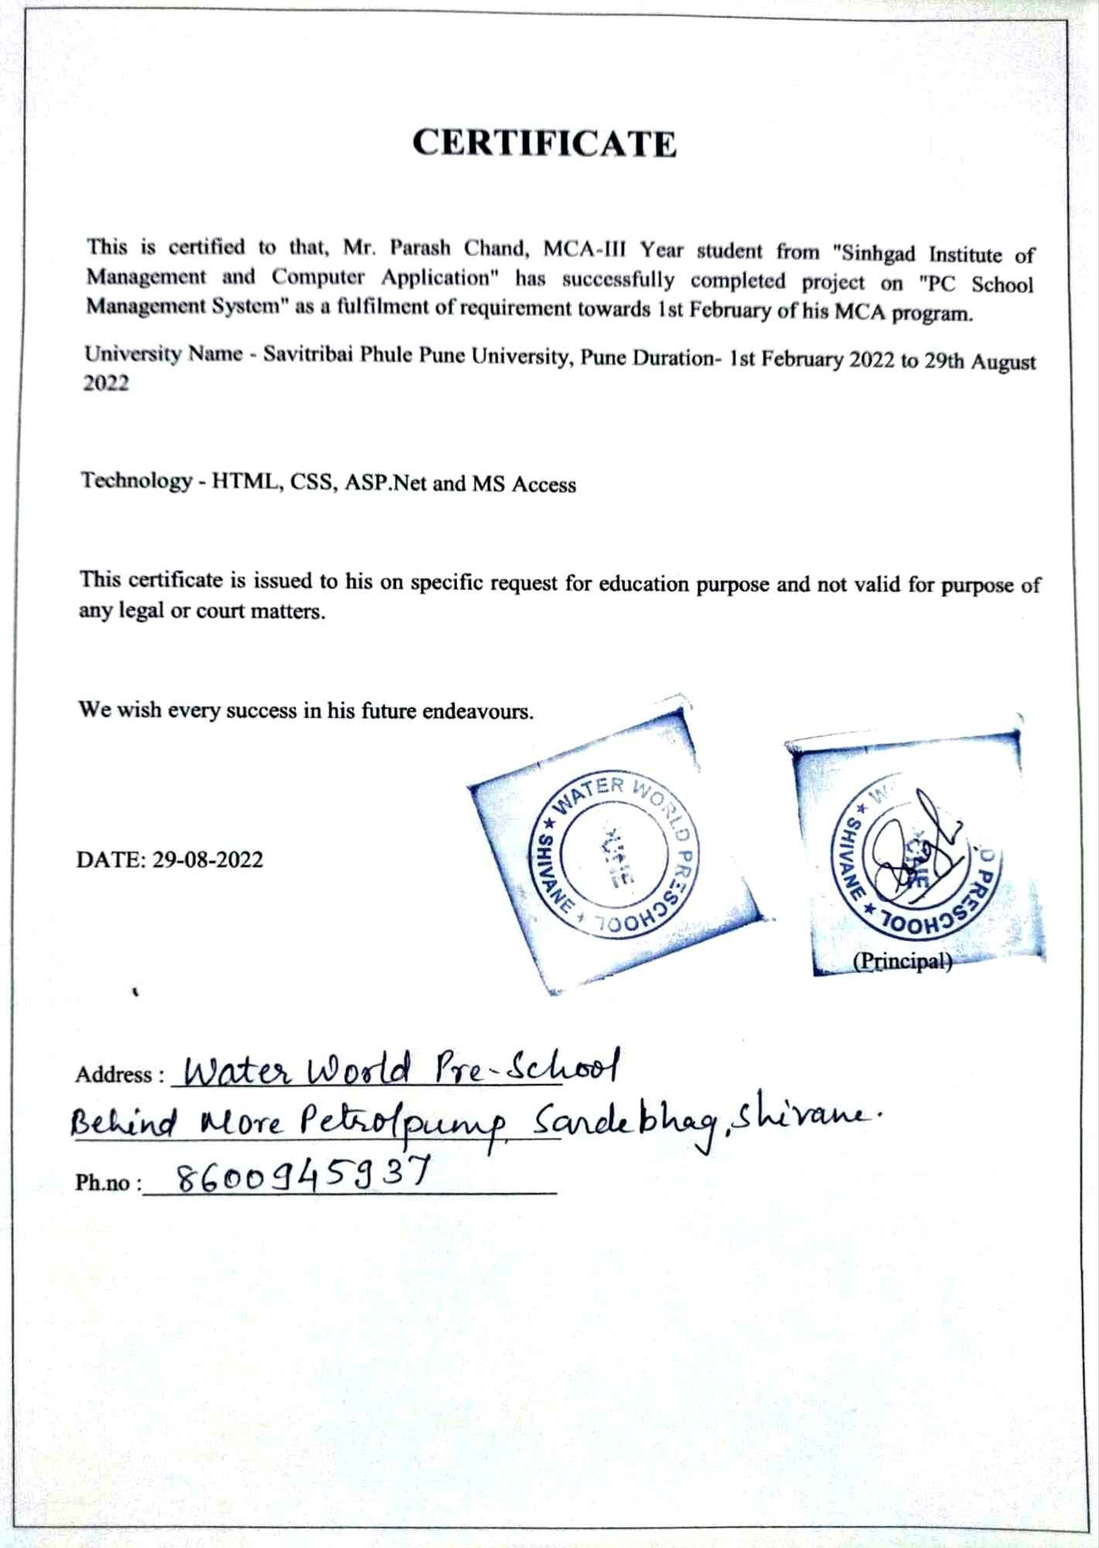

Slide 6
1. Introduction
The objective of the automated PC School Management System is to simplify the day-to-day processes of the system.
The aim of developing the proposed system is to improve facilities. The proposed system can overcome all the limitations of the existing system. The system provides proper security and reduces manual work.

Slide 7
1.2 Abstract
This work automates PC School Management System application. I tried to use different software for this application. Using this software approaches I have completed this application.
The PC School Management System is a application based system which will use as a platform for interaction between principle, student, staff and parents. While the main objective of this project is to computerize the paperwork in the system and automate the work.

Slide 8
1.3 Existing System and Need for System
Problem with Existing System:
Lack of security of school information.
Require more physical work and man power.
Time consuming for manual entry and editing data.
Consumes large volume of paper work.
Needs manual calculations of attendance sheet, marks of students, payment.
Damage of entry book school information loss and no backup of information.
Also maintained of student records is difficult for teachers.
Manually manage teacher’s details and payment.

Slide 9
1.4 Scope of System
I want to build a window application for school teachers, principal, students, admin which will be very easy to use for their work purpose. Work with common application which is very familiar with us. Security will be simple but if it is need to be build a high security then it will be built later. I want to focus on the application itself and the features of that application that help build a good management system.

Slide 10
1.5 Operating Environment - Hardware and Software
Hardware and Software Requirement:
Hardware Requirement:
1. Operating System supports all known operating systems, such as Windows 7 or higher.
2. Computer 4GB RAM, monitor with minimum resolution of 1024x768.
3. Hard Drive should be in NTFS file-system formatted with minimum 10 GB of free space.
4. A Laser printer will need to be used to print these reports and notes.
Software Requirement:
1. Software is designed to run on window platform above Microsoft Windows 7 or higher.
2. Microsoft .NET Frameworks 3.5 or above.
3. Microsoft Visual Studio 2010 and Microsoft Access.

Slide 11
1.6 Brief Description of Technology Used
ASP.NET
It is a sophisticated and powerful web development framework. Development with ASP.NET requires not only an understanding of HTML and web design, but a firm grasp of the concepts of object oriented programming and development. ASP.NET is a server-side technology for developing web applications based on the Microsoft .NET Framework.
VB.NET
VB.NET is an object-oriented computer programming language implemented on the .NET Framework. Although it is an evolution of classic Visual Basic language, it is not backwards-compatible with VB 6 and any code written in the old version does not compile under VB.NET. As a language, Visual Basic.NET has the following traits:

Slide 12
2 Proposed System
The PC School Management System will manage all the work in any school in particular order so that the time requirement and complexity of the system will be reduced, at first it will focus on student related information.
As a student gets the admission in the school system will start managing the details regarding the students. It will manage the fee details, and if the full payment has not done, then it will notify about the fee to a staff of the school.

Slide 13
2.2 Feasibility Study
Feasibility Study
Economic feasibility:
Legal Feasibility:
Technical Feasibility:
Behavioral Feasibility:

Slide 14
2.3 Objectives of Proposed System
The system is very simple in design and to implement. The system requires very low system resources and the system will work in almost all configurations. It has got following features:-
Less paper work and man power.
Safeguard to ensure data accuracy.
Minimize manual data entry and record keeping.
Minimum time needed for the various processing.
Better service for maintaining of data.
24/7 anytime and anywhere access to the system.

Slide 15
2.4 Users of System
User of System
Principal
Admin
Director
Student
Teacher
Staff
Child
Candidate

Slide 16
3. Analysis and Design
Functional Requirements
Principal
Admin
Director
Student
Non Teaching Staff
Candidate
Child
Teacher
Nonfunctional Requirements
Availability
Security
Maintainability
Performance Requirements
Reliability
Portability

Slide 17
3.3 Table Structure
Admin
Field Name | Data Type | Width | Constraint | Description
Admin_ Email_Id | Text | 30 | Primary Key | Uniquely Identify user on a system.
Admin _Password | Text | 18 |  | Authenticate a user on a system.

Slide 18
Expense
Field Name | Data Type | Width | Constraint | Description
Expense_Id | Number | 5 | Primary Key | Expenses id is a unique identify.
Vendor_Name | Text | 30 |  | Display vendor name.
Expense _Name | Text | 20 |  | Identify user on a system.
Expense _Date | Date/Time | - |  | Display Date of expense.
Expense _Transaction _Type | Text | 10 |  | Display which way of transaction type: cash, cheque.
Expense _Amount | Number | 10 |  | Display Individual expense amount.

Slide 19
Vacancy
Field Name | Data Type | Width | Constraint | Description
Vacancy_ID | Number | 5 | Primary Key | Vacancy ID is a unique identify.
Vacancy _Designation | Text | 18 |  | Display vacancy designation.
Start_Date | Date/Time | - |  | Display start date.
End_Date | Date/Time | - |  | Display end date.

Slide 20
Candidate
Field Name | Data Type | Width | Constraint | Description
Candidate_ID | Number | 5 | Primary Key | Upload ID is a unique identify.
Candidate_Email _ID | Text | 30 |  | Display email id of candidate.
Candidate _Password | Text | 18 |  | Authenticate a user on a system.
Candidate_Name | Text | 30 |  | Identify user on a system.
Candidate_ Year_of_Exprience | Number | 2 |  | Display year of experience.
Candidate_ Qualification | Text | 10 |  | Display Qualification.
Candidate _Mobile _Number | Number | 10 |  | Display 10 digit mobile number.
Candidate_Photo | Text | 20 |  | Display photo.

Slide 21
School Activity
Field Name | Data Type | Width | Constraint | Description
Activity_ID | Number | 5 | Primary Key | Activity ID is a unique identify.
Activity_Name | Text | 10 |  | Identify user on a system.
Activity_Date | Date/Time | - |  | Date of activity.
Activity_Class _Standard | Text | 4 |  | Display class standard.

Slide 22
Class
Field Name | Data Type | Width | Constraint | Description
Class_ID | Number | 5 | Primary Key | Class ID is a unique identify.
Class_Year | Number | 4 |  | Display class year.
Class_Standard | Text | 5 |  | Display class standard.
Student_Intake | Number | 4 |  | Display student intake.

Slide 23
Subject
Field Name | Data Type | Width | Constraint | Description
Subject_ID | Number | 5 | Primary Key | Subject ID is a unique identify.
Subject_Name | Text | 20 |  | Display subject name.
Class_ID | Number | 5 | Primary Key | Class ID is a unique identify.
Teacher_ID | Number | 5 | Foreign Key | Teacher ID is a unique identify.

Slide 24
Staff
Field Name | Data Type | Width | Constraint | Description
Staff_ID | Number | 5 | Primary Key | Staff ID is a unique identify.
Staff_Email_ID | Text | 30 |  | Display email id of staff.
Staff_Password | Text | 18 |  | Authenticate a user on a system.
Staff_Name | Text | 30 |  | Identify user on a system.
Post | Text | 20 |  | Display staff post.
Staff_Designation | Text | 50 |  | Display staff working name.
Teacher_Type | Text | 20 |  | Display teacher type.
Staff_Date_of _Joining | Date/Time | - |  | Joining date of staff.
Staff_Mobile _Number | Number | 10 |  | Display 10 digit mobile number.
Staff_Photo | Text | 20 |  | Display staff photo on a system.
Staff_Resume | Text | 20 |  | Display staff resume on a system.

Slide 25
Staff Salary
Name | Data Type | Width | Constraint | Description
Salary_ID | Number | 5 | Primary Key | Salary id is a unique identify.
Staff_Date | Date/Time | - |  | Display staff salary date.
Basic_Pay | Number | 10 |  | Display basic pay Amount.
Grade_ Level | Text | 10 |  | Display grade level amount.
Grade_Pay | Number | 10 |  | Display grade pay amount.
HRA | Number | 10 |  | Display HRA amount.
DA | Number | 10 |  | Display DA amount.
TA | Number | 10 |  | Display TA amount.
Gross_Salary | Number | 10 |  | Display gross salary amount.
PF | Number | 10 |  | Display PF amount.
Additional_ Deduction | Number | 10 |  | Display additional deduction.
Net_Salary | Number | 10 |  | Display net salary amount.
Staff_ID | Number | 5 | Foreign Key | Staff ID is a unique identify.

Slide 26
Register
Field Name | Data Type | Width | Constraint | Description
Register _ID | Number | 5 | Primary Key | Staff Register ID is a unique identify.
Attendance_Type | Text | 8 |  | Display present and absent status.
Register_Date | Date/Time | - |  | Staff total count of no of days.
Staff_ID | Number | 5 | Foreign Key | Staff ID is a unique identify.

Slide 27
Fee
Field Name | Data Type | Width | Constraint | Description
Fee_ID | Number | 5 | Primary Key | Fee ID is a unique identify.
Class_Name | Text | 5 |  | Identify user on a system.
Admission_Fee | Number | 5 |  | Display admission fee type.
Re_Admission _Fee | Number | 5 |  | Display re admission fee type.
Tuition_Fee | Number | 5 |  | Display tuition fee.
Computer_Fee | Number | 5 |  | Display Computer fund.
Development _Fee | Number | 5 |  | Display Computer fund.
Late_Fee | Number | 5 |  | Display late fee.
Fee_Start_Date | Date/Time | - |  | Display start date.
Fee_End_Date | Date/Time | - |  | Display end date.
Quarterly_Period | Number | 5 |  | Display quarterly period.
Quarterly_Fee | Number | 5 |  | Display quarterly fee.
Fee_Amount | Number | 5 |  | Display fee amount.
Total_Fee | Number | 5 |  | Display total fee.
Total_Month _Period | Number | 5 |  | Display total month period.
Fee_Status | Text | 10 |  | Display fee status.

Slide 28
Payment
Field Name | Data Type | Width | Constraint | Description
Payment_ID | Number | 5 | Primary Key | Payment ID is a unique identify.
Payment _Date | Date/Time | - |  | Display payment date.
Payment _Mode | Text | 15 |  | Display payment mode.
Payment _Type | Text | 15 |  | Display payment type.
Pay_Amount | Number | 10 |  | Display pay amount.
Payment _Status | Text | 10 |  | Display payment status.
Student_ID | Number | 5 | Foreign Key | Student ID is a unique identify.
Fee_ID | Number | 5 | Foreign Key | Fee ID is a unique identify.

Slide 29
Test Result
Field Name | Data Type | Width | Constraint | Description
Test_ID | Number | 5 | Primary Key | Test Id is a unique identify.
Test_Name | Text | 20 |  | Display test name.
Test_Subject _Name | Text | 50 |  | Display test subject name.
Marks | Number | 2 |  | Display marks.
Total_Marks | Number | 3 |  | Display total marks.
Test_Date | Date/Time | - |  | Display test date.
Test_Result_Date | Date/Time | - |  | Display test result date.

Slide 30
Student
Field Name | Data Type | Width | Constraint | Description
Student_ID | Number | 5 | Primary Key | Student Id is a unique identify.
Student_Roll _Number | Number | 5 |  | Display student roll number.
Student_Email_Id | Text | 30 |  | Display email id of student.
Student_Password | Text | 18 |  | Authenticate a user on a system.
School_Year | Date/Time | - |  | Display current year of student.
Student_Name | Text | 50 |  | Identify user on a system.
Student_Address | Text | 200 |  | Display address of student.
Student_Gender | Text | 6 |  | Display male and female of gender.
Student_Date_Of _Birth | Date/Time | - |  | Display date of birth of student.

Slide 31
Student_Mobile _Number | Number | 10 | Not Null | Display 10 digit mobile number.
Student_Class_Standard | Text | 5 | Not Null | Display class standard.
Student_Caste | Text | 10 | Not Null | Display caste of student.
Student_Father_Name | Text | 50 | Not Null | Identify user on a system.
Student _Mother _Name | Text | 50 | Not Null | Identify user on a system.
Admission_ID | Number | 5 | Foreign Key | Admission Id is a unique identify.
Class_ID | Number | 5 | Foreign Key | Class ID is a unique identify.

Slide 32
Student Attendance
Name | Data Type | Width | Constraint | Description
Attendance_ID | Number | 5 | Not Null | Attendance id is a unique identify.
Student_Roll _Number | Number | 5 | Not Null | Roll number is a unique identify.
Student_ Attendance_Type | Text | 10 | Not Null | Display student attendance type.
Attendance_Date | Date/Time | - | Not Null | Display attendance date.
No_of_Day | Number | 2 | Not Null | Display no of day.
No_of_meeting | Number | 2 | Not Null | Display no of meeting.
Total_Present | Number | 2 | Not Null | Display total present.
Total_Absent | Number | 2 | Not Null | Display total absent.
Student_ID | Number | 5 | Foreign Key | Student ID is a unique identify.

Slide 33
Admission
Field Name | Data Type | Width | Constraint | Description
Admission _ID | Number | 5 | Primary Key | Admission Id is a unique identify.
Email_ID | Text | 30 | Not Null | Display email id.
Password | Text | 18 | Not Null | Authenticate a user on a system.
Admission_ Year | Number | 4 | Not Null | Display admission year.
Admission _Date | Date/Time | - | Not Null | Display admission date.
Admission_ Class | Text | 5 | Not Null | Display admission class.
Name | Text | 50 | Not Null | Display name.
Date_of _Birth | Date/Time | - | Not Null | Display date of birth.
Address | Text | 200 | Not Null | Display address.
Gender | Text | 6 | Not Null | Display male, female and other.
Mobile_ Number | Number | 10 | Not Null | Display 10 digit mobile number.

Slide 34
Caste_ Category | Text | 10 | Not Null | Display caste category.
Nationality | Text | 10 | Not Null | Display nationality.
Father_ Name | Text | 50 | Not Null | Display father name.
Mother _Name | Text | 50 | Not Null | Display mother name.
Father_ Occupation | Text | 50 | Not Null | Display father occupation.
Mother_ Occupation | Text | 50 | Not Null | Display mother occupation.

Slide 35
Data Dictionary
Sr. No. | Field Name | Type | Size | Constraint
1 | Activity_Class _Standard | Text | 4
2 | Activity_Date | Date/Time | -
3 | Activity_ID | Number | 5 | Primary Key
4 | Activity_Name | Text | 10
5 | Additional_ Deduction | Number | 10
6 | Admin _Password | Text | 18
7 | Admin_Email_ID | Text | 30 | Primary Key
8 | Admission _ID | Number | 5 | Foreign Key
9 | Admission_Fee | Number | 5
10 | Attendance_Date | Date/Time | -
11 | Attendance_ID | Number | 5 | Primary Key
12 | Attendance_Type | Text | 8
13 | Basic_Pay | Number | 10
14 | Candidate _Mobile_Number | Number | 10
15 | Candidate_Email_ID | Text | 30
16 | Candidate_ID | Number | 5 | Primary Key
17 | Candidate_Name | Text | 30
18 | Candidate_Password | Text | 18
19 | Candidate_Photo | Text | 20
20 | Candidate_Qualification | Text | 10

Slide 36
21 | Candidate_Resume | Text | 20
22 | Candidate_Year_of_Exprience | Number | 2
23 | Class_ID | Number | 5 | Foreign Key
24 | Class_Name | Text | 5
25 | Class_Standard | Text | 4
26 | Class_Year | Number | 4
27 | Computer_Fee | Number | 5
28 | DA | Number | 10
29 | Development_Fee | Number | 5
30 | End_Date | Date/Time | -
31 | Expense_Amount | Number | 10
32 | Expense_Date | Date/Time | -
33 | Expense_ID | Number | 5 | Primary Key
34 | Expense_Name | Text | 20
36 | Expense_Transaction_Type | Text | 10
37 | Fee_Amount | Number | 5
38 | Fee_End_Date | Date/Time | -
39 | Fee_ID | Number | 5 | Primary Key

Slide 37
40 | Fee_ID | Number | 5 | Foreign Key
41 | Fee_Start_Date | Date/Time | -
42 | Fee_Status | Text | 10
43 | Grade_ Level | Text | 10
44 | Grade_Pay | Number | 10
45 | Gross_Salary | Number | 10
46 | HRA | Number | 10
47 | Late_Fee | Number | 5
48 | Net_Salary | Number | 10
49 | Pay_Amount | Number | 10
50 | Payment_Date | Date/Time | -
51 | Payment_Mode | Text | 15
52 | Payment_Type | Text | 15
53 | Payment_Status | Text | 10
54 | Payment_ID | Number | 5 | Primary Key
55 | PF | Number | 10
56 | Post | Text | 20
57 | Quarterly_Fee | Number | 5
58 | Quarterly_Period | Number | 5

Slide 38
59 | Re_Admission_Fee | Number | 5
60 | Register_Date | Date/Time | -
61 | Register_ID | Number | 5 | Primary Key
62 | Salary_Date | Date/Time | -
63 | Salary_ID | Number | 5 | Primary Key
64 | Staff_Date_of_Joining | Date/Time | -
65 | Staff_Designation | Text | 50
66 | Staff_Email_ID | Text | 30
67 | Staff_ID | Number | 5 | Foreign Key
68 | Staff_Mobile_Number | Number | 10
69 | Staff_Name | Text | 30
70 | Staff_Password | Text | 18
71 | Staff_Photo | Text | 20
72 | Start_Date | Date/Time | -
73 | Student _Password | Text | 18
74 | Student _Gender | Text | 10
75 | Student _Mobile _Number | Number | 10
76 | Student _Photo | Number | 20

Slide 39
77 | Student_Mother_Name | Text | 30
78 | Student_Attendance_Type | Text | 10
79 | Student_Address | Text | 200
80 | Student_Caste | Text | 10
81 | Student_Class_Standard | Text | 5
82 | Student_Date_of_Birth | Date/Time | -
83 | Student_Email_ID | Text | 30
84 | Student_Father_Name | Text | 30
85 | Student_ID | Number | 5 | Primary Key
86 | Student_Intake | Number | 4
87 | Student_Name | Text | 30
88 | Student_Roll_Number | Number | 5
89 | Subject_ID | Number | 5 | Foreign Key
90 | Subject_Name | Text | 20
91 | TA | Number | 10

Slide 40
92 | Teacher_ID | Number | 5 | Foreign Key
93 | Teacher_Type | Text | 20
94 | Total_Fee | Number | 5
95 | Total_Month _Period | Number | 5
96 | Tuition_Fee | Number | 5
97 | Vacancy_Designation | Text | 18
98 | Vacancy_ID | Number | 5 | Primary Key
99 | Vendor_Name | Text | 30

Slide 41
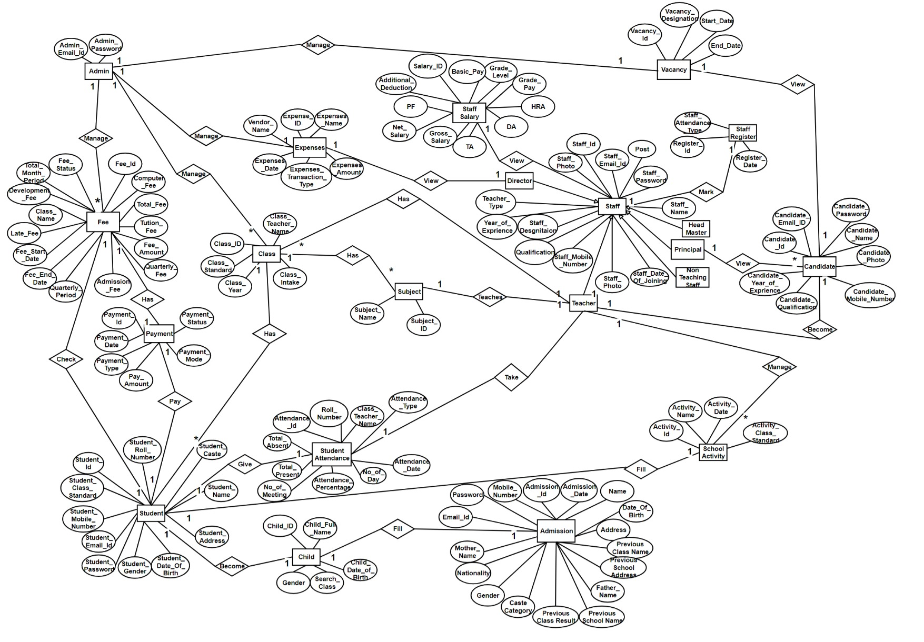
3.2 Entity Relationship Diagram (ERD)

Slide 42
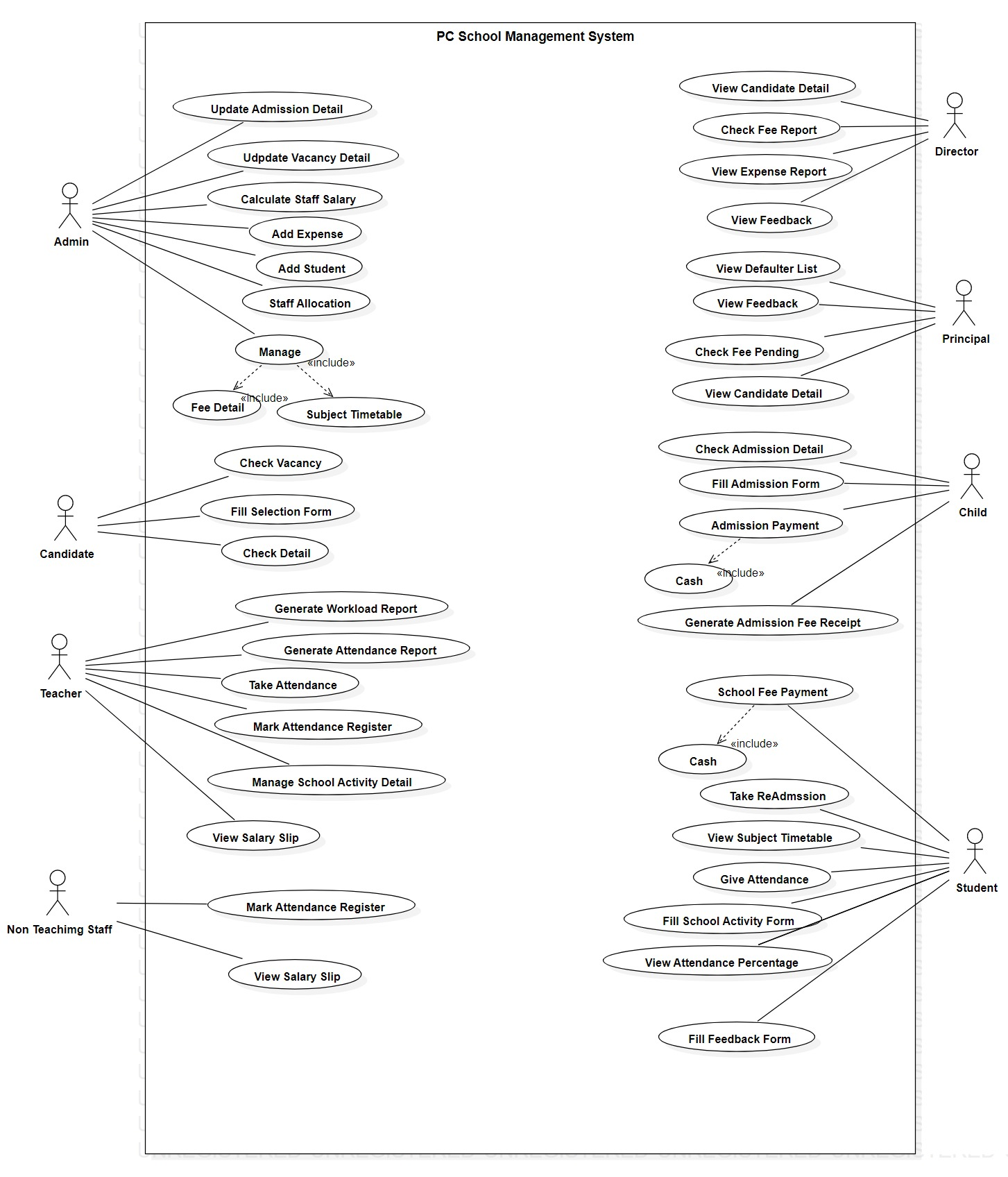
3.4 Use Case Diagrams

Slide 43
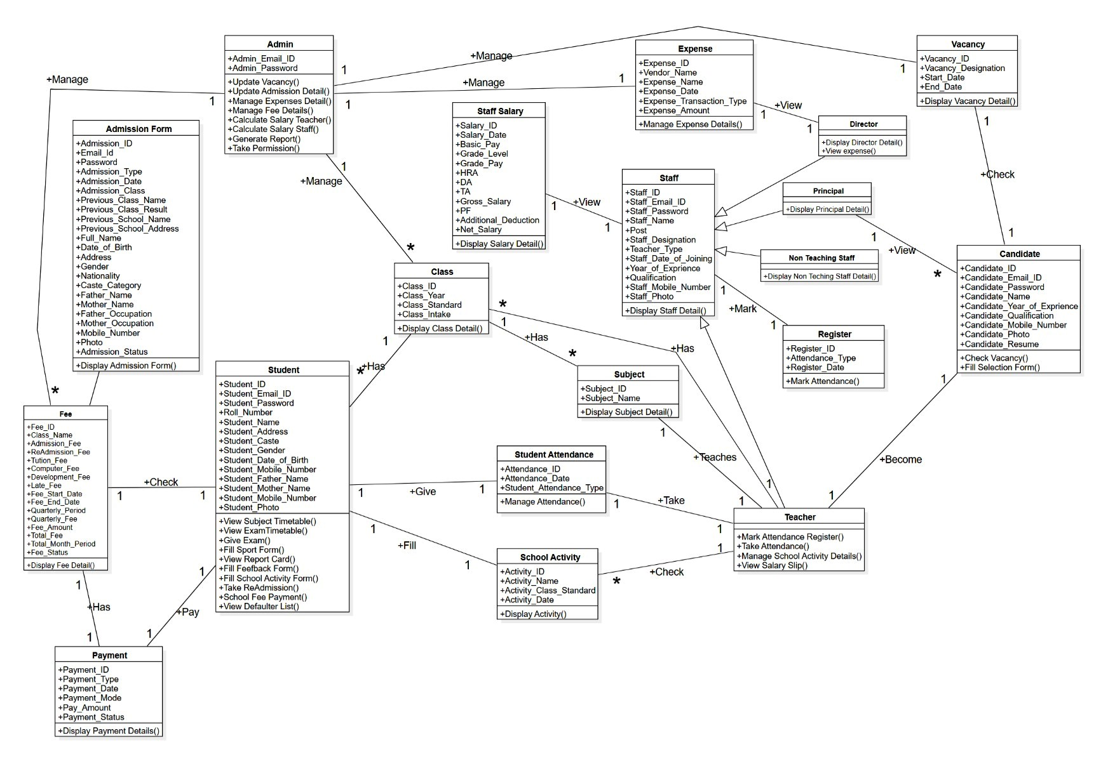
3.5 Class Diagram

Slide 44
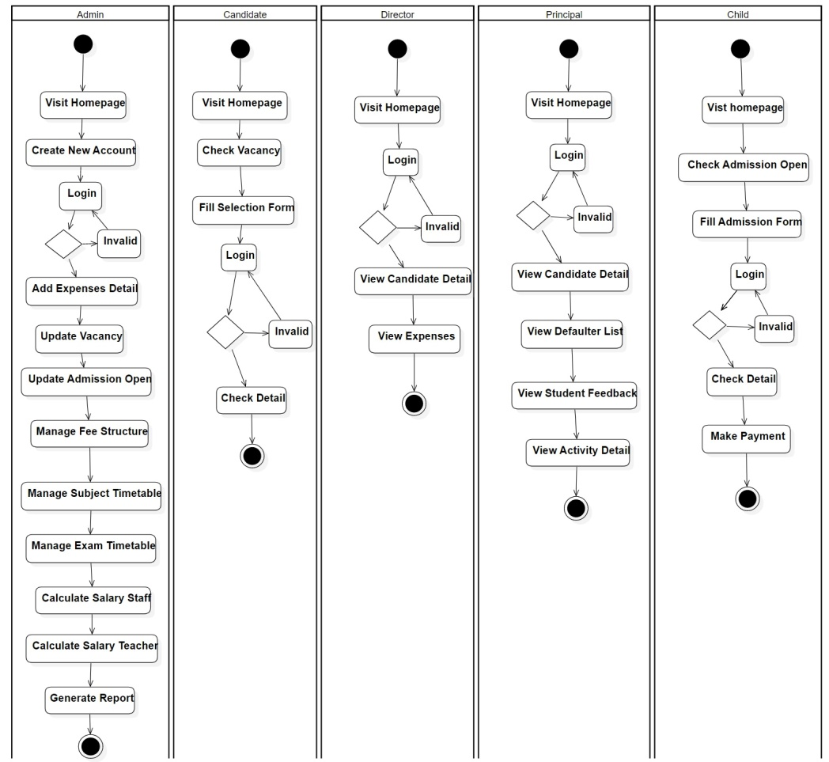
3.6 Activity Diagram

Slide 45
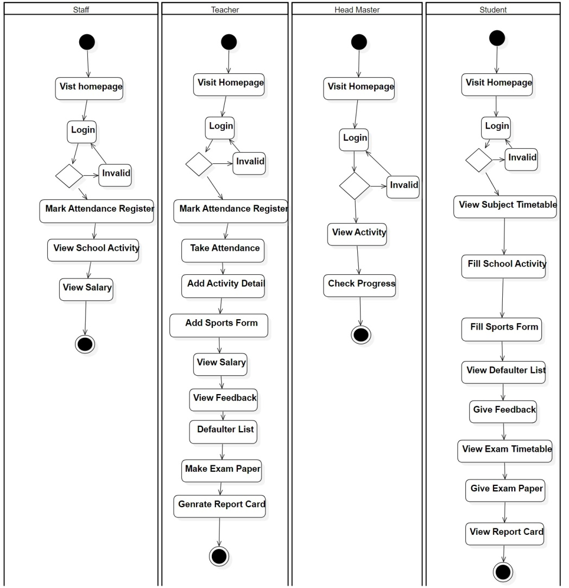

Slide 46
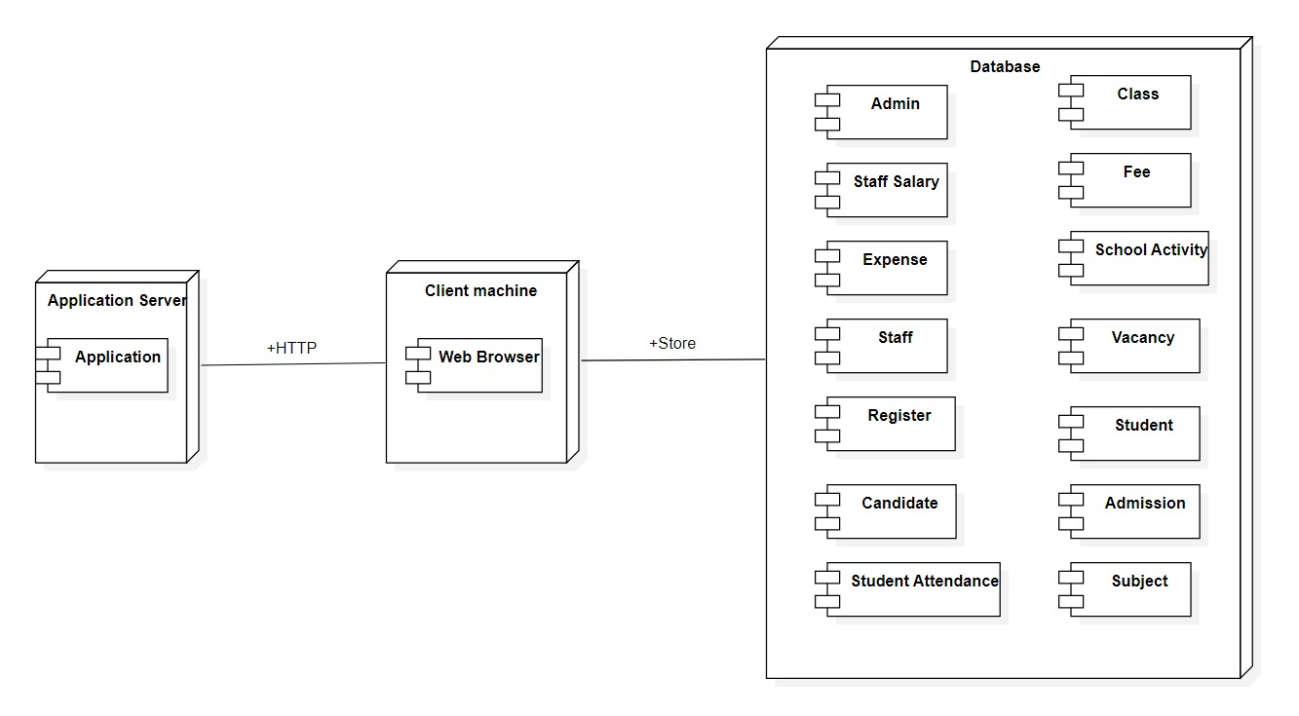
3.7 Deployment Diagram

Slide 47
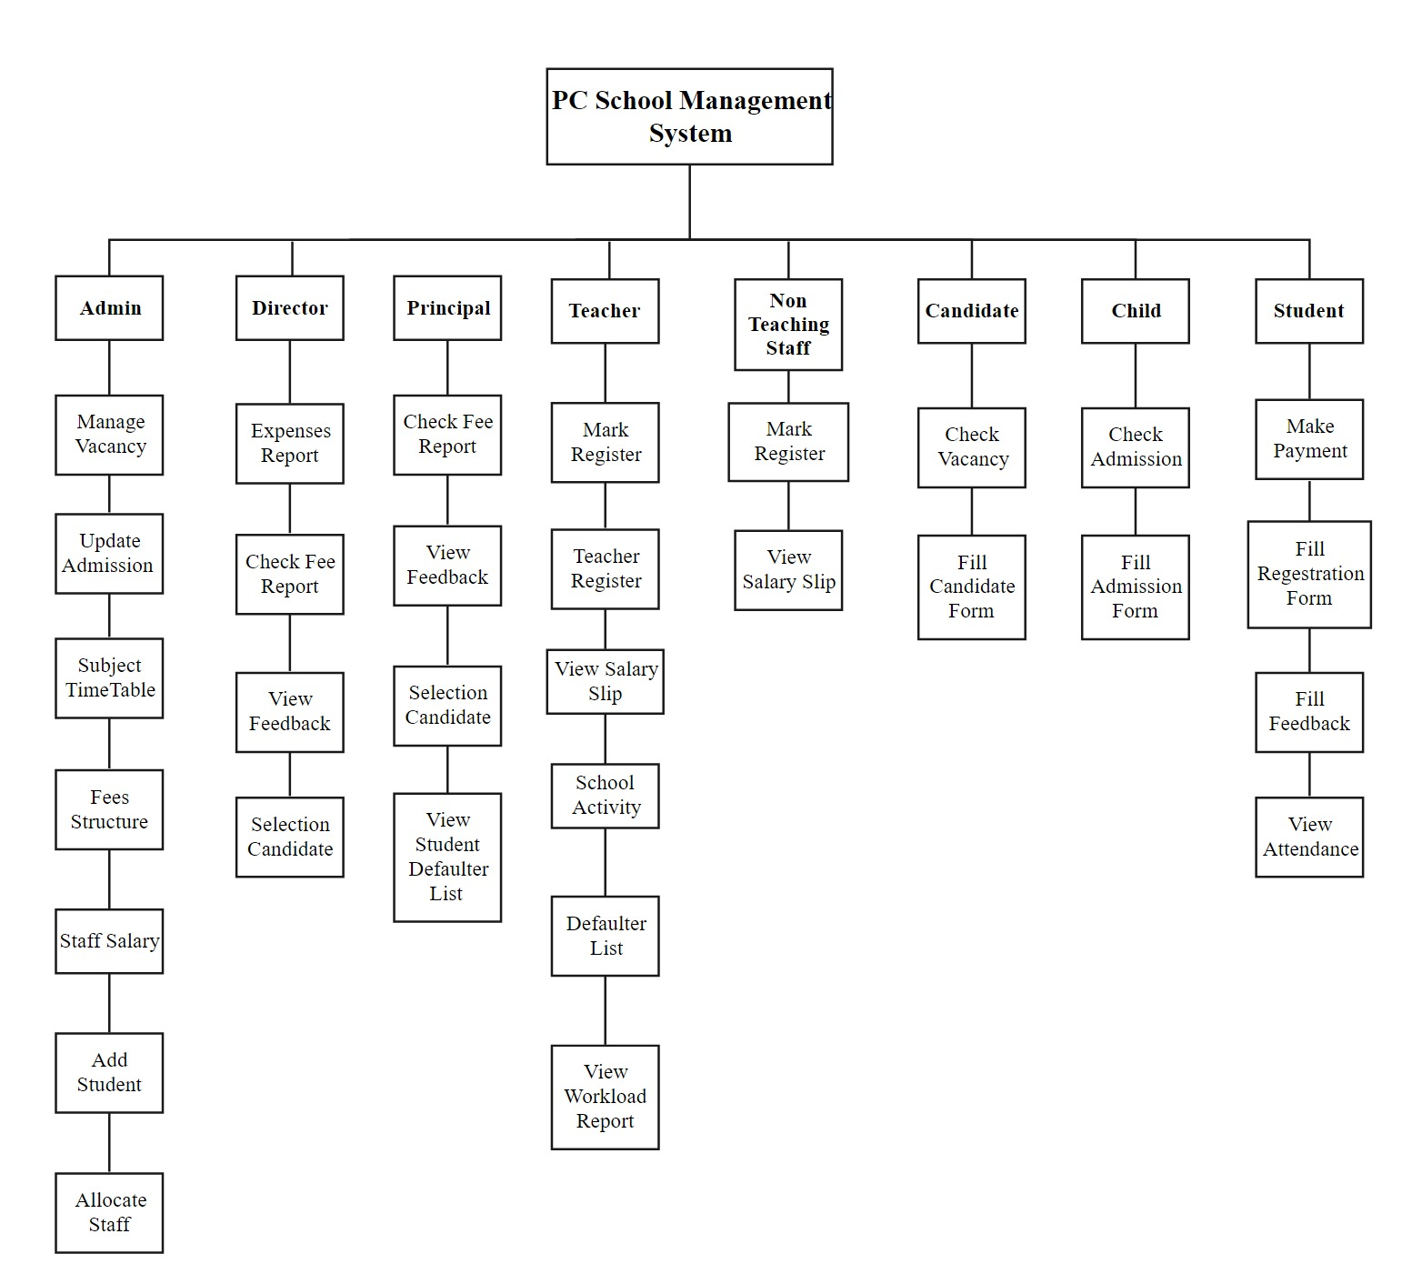
3.8 Module Hierarchy Diagram

Slide 48
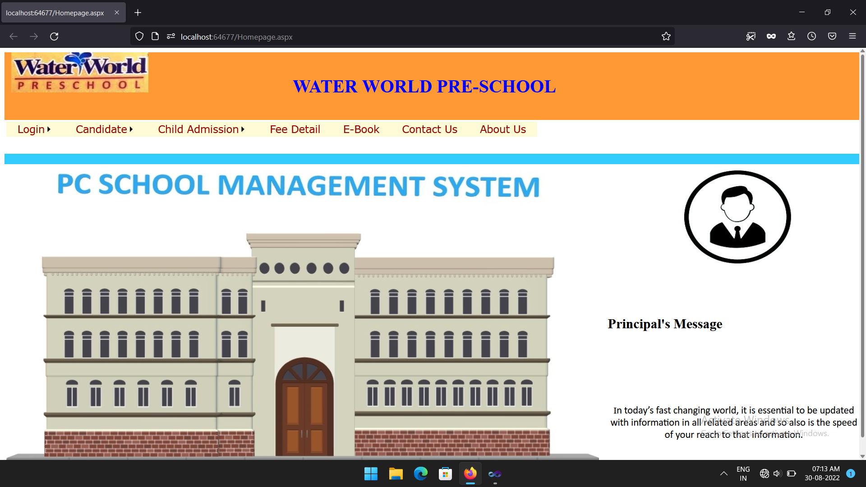
3.9 Sample Input and Output Screens

Slide 49
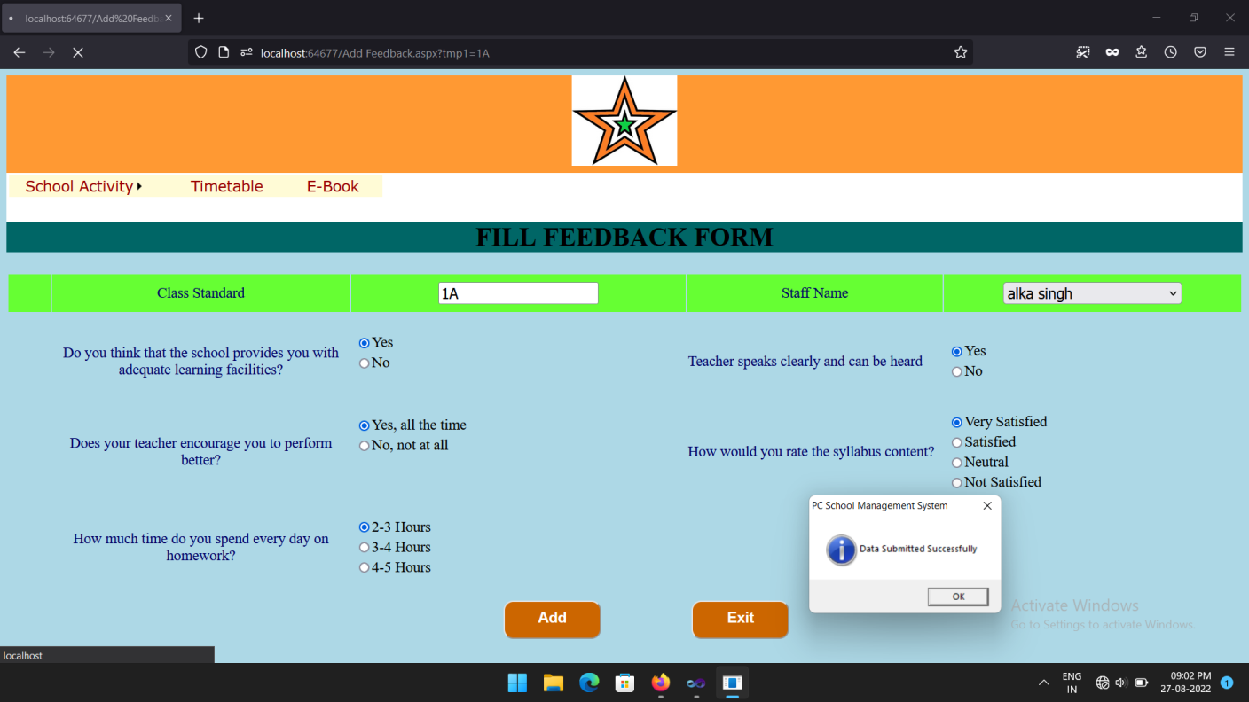

Slide 50
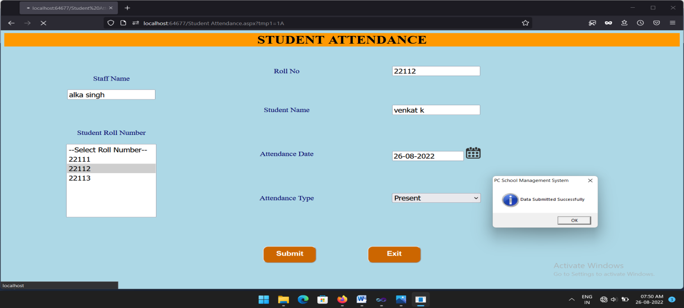

Slide 51
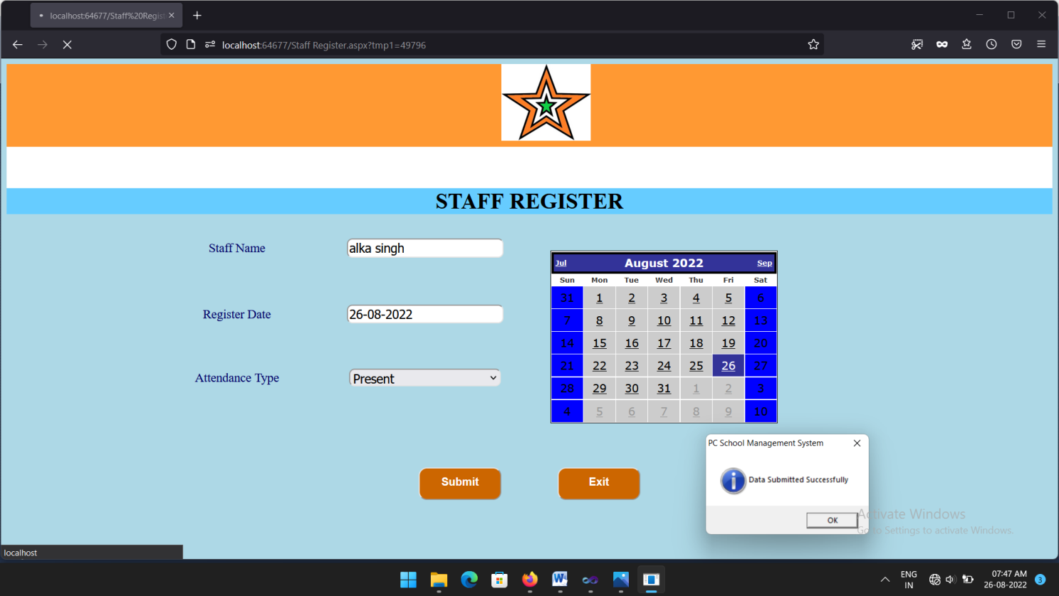

Slide 52
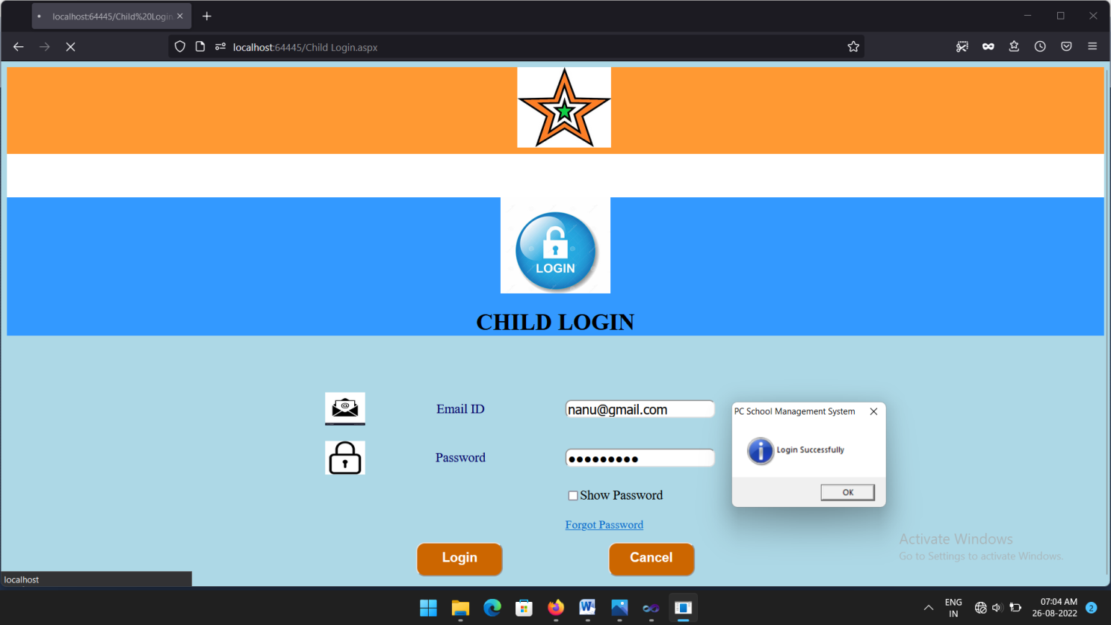

Slide 53
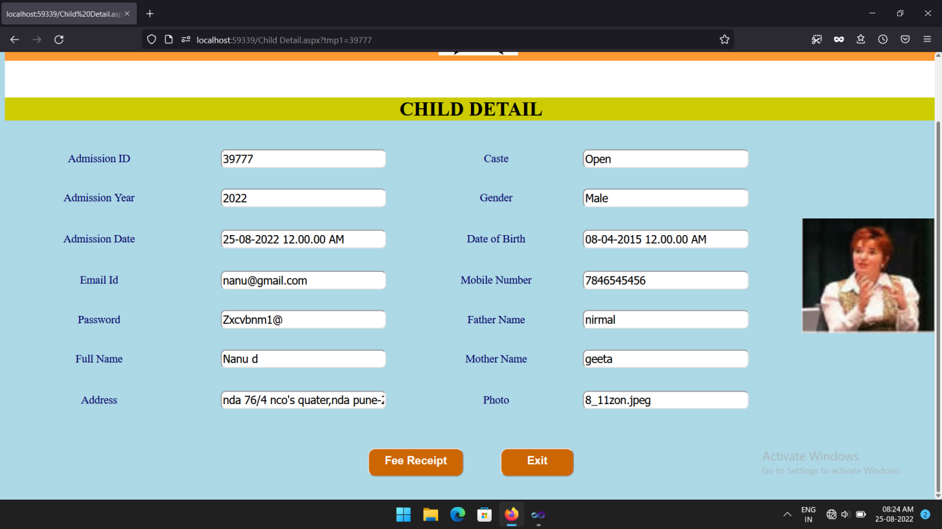

Slide 54
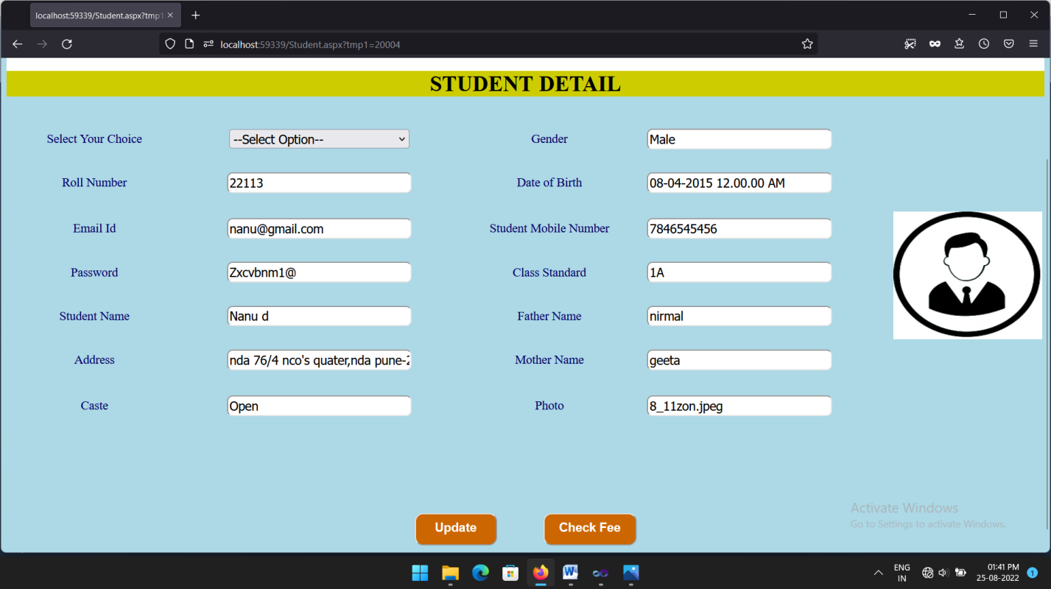

Slide 55
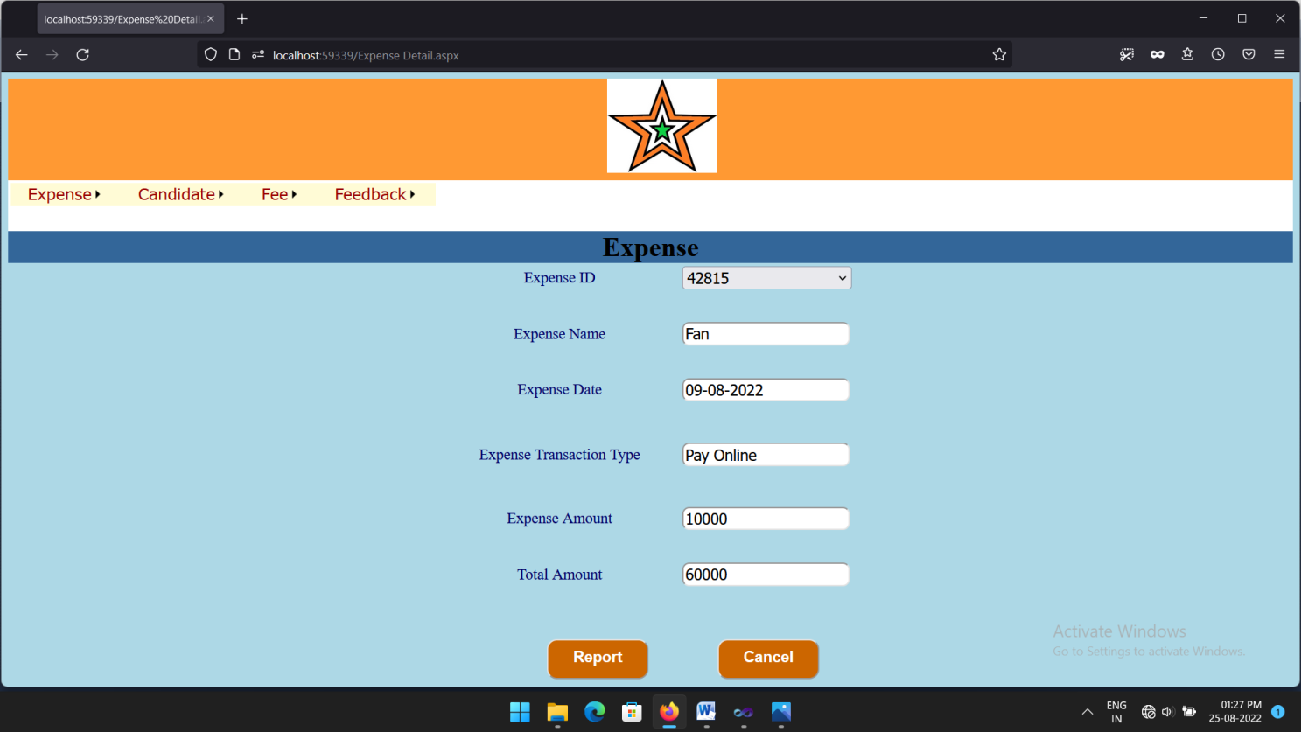

Slide 56
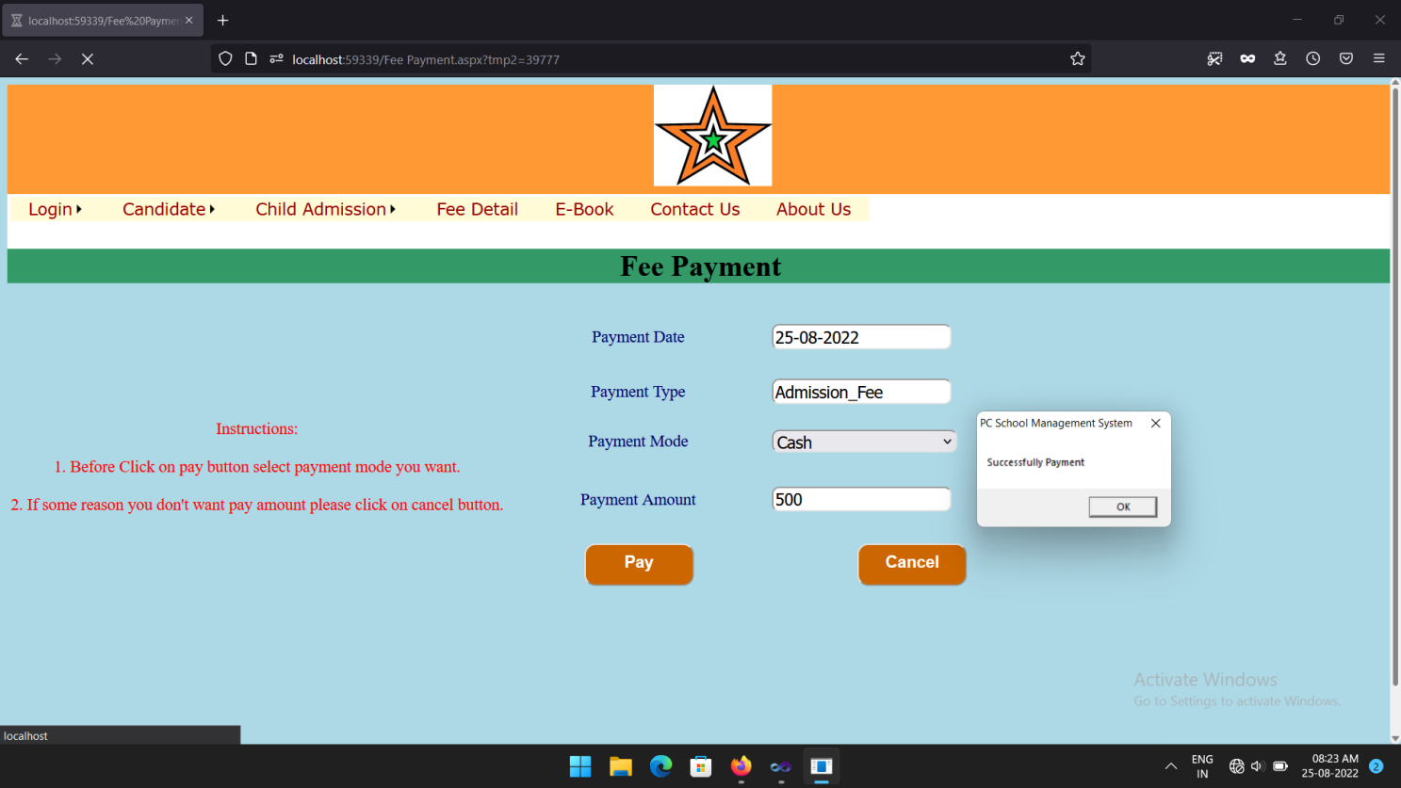

Slide 57
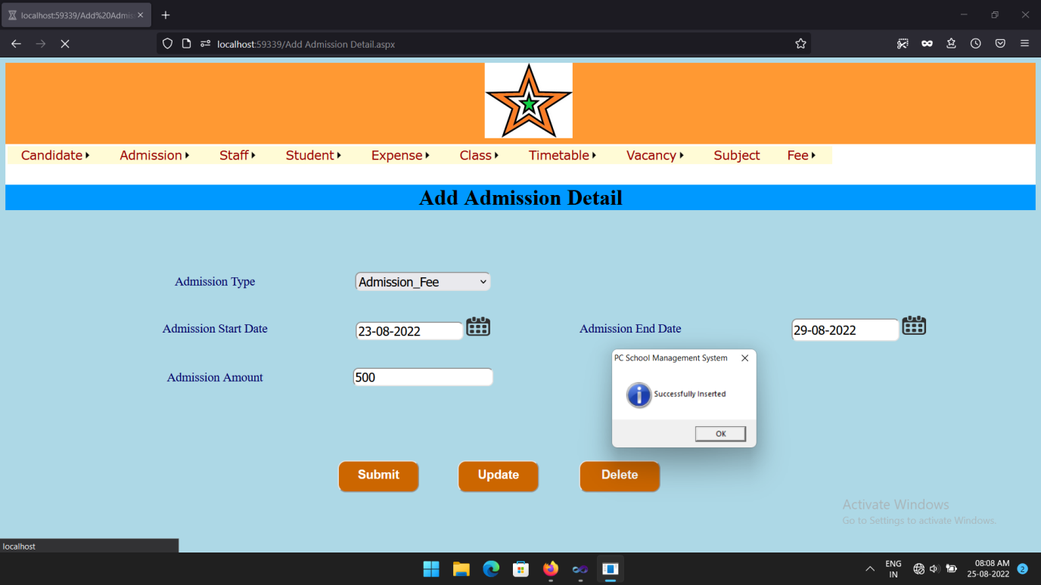

Slide 58
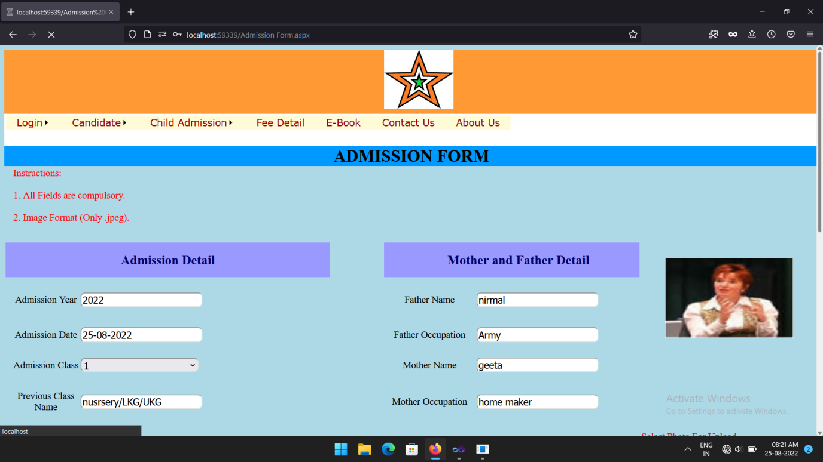

Slide 59
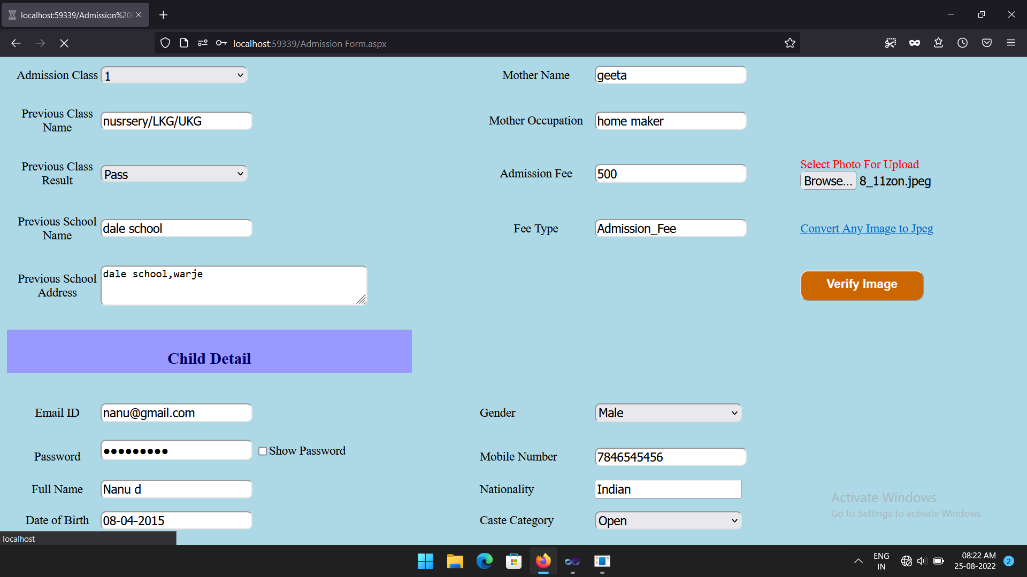

Slide 60
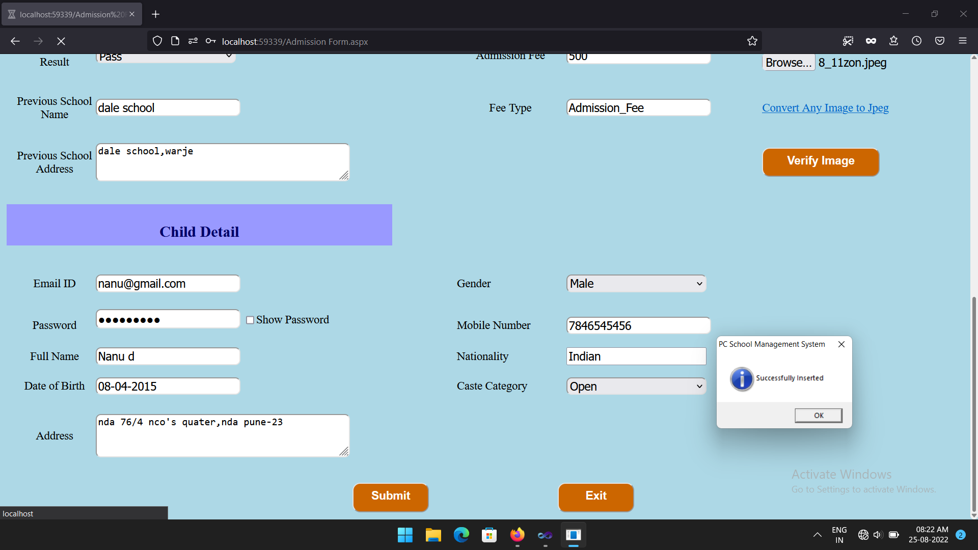

Slide 61
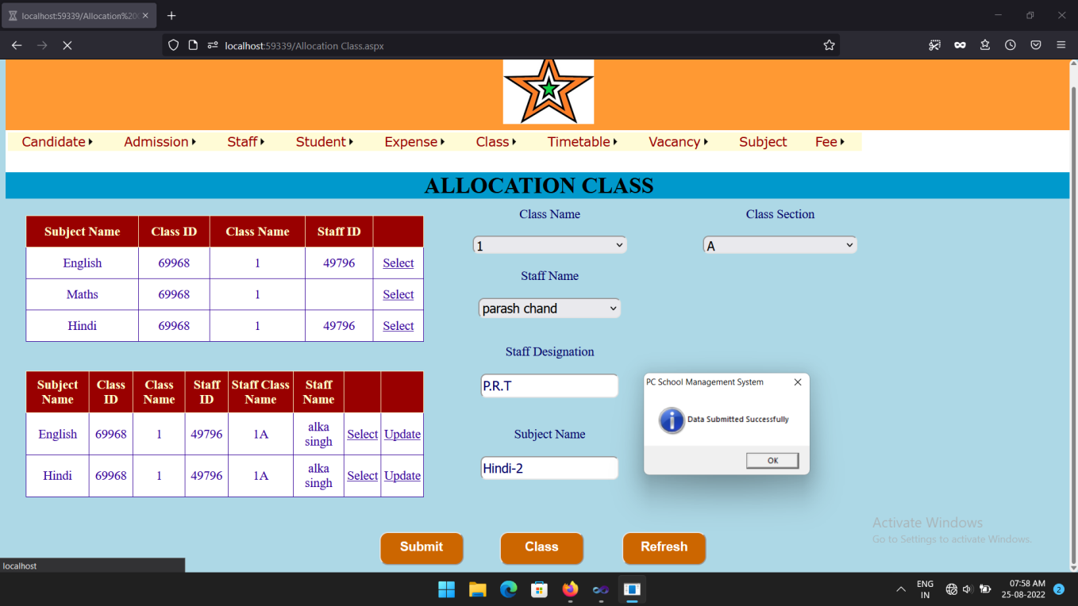

Slide 62
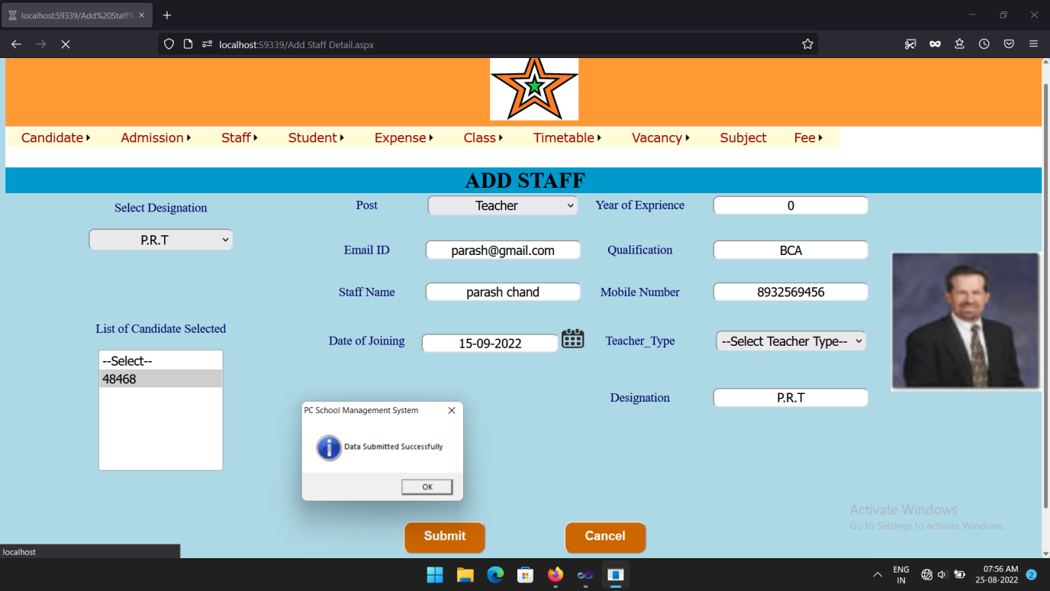

Slide 63
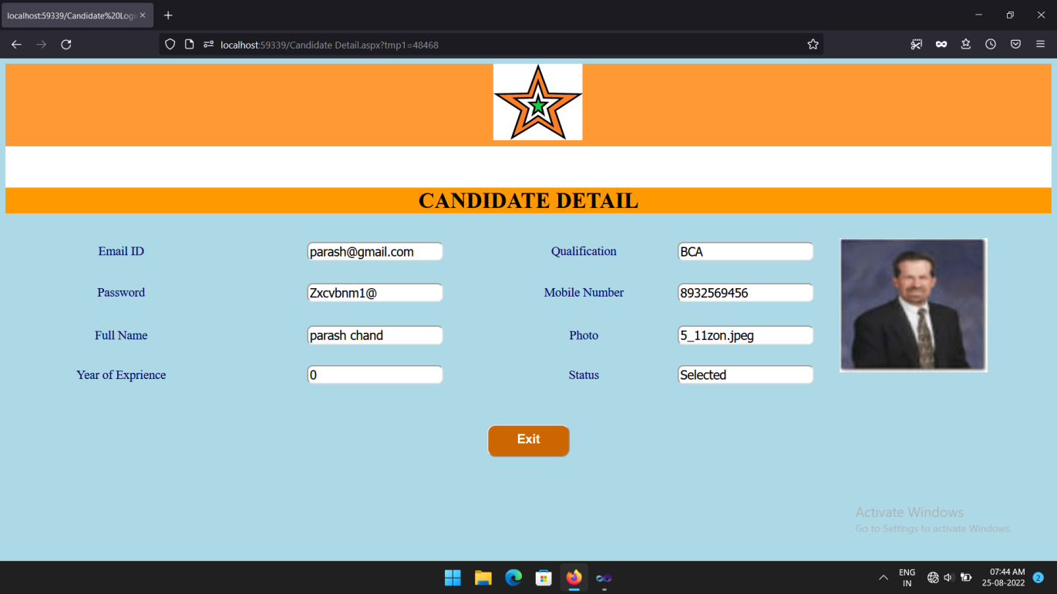

Slide 64
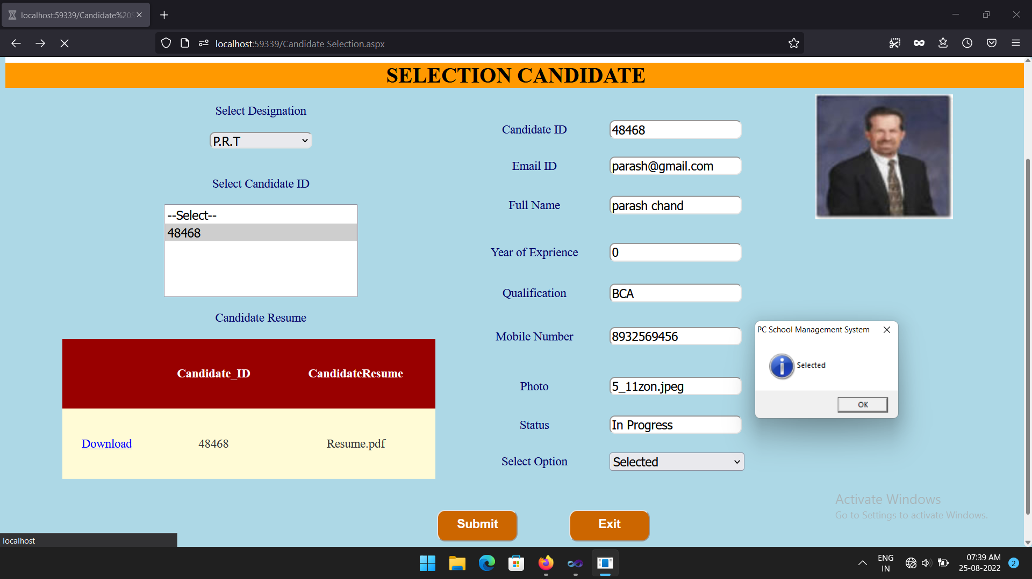

Slide 65
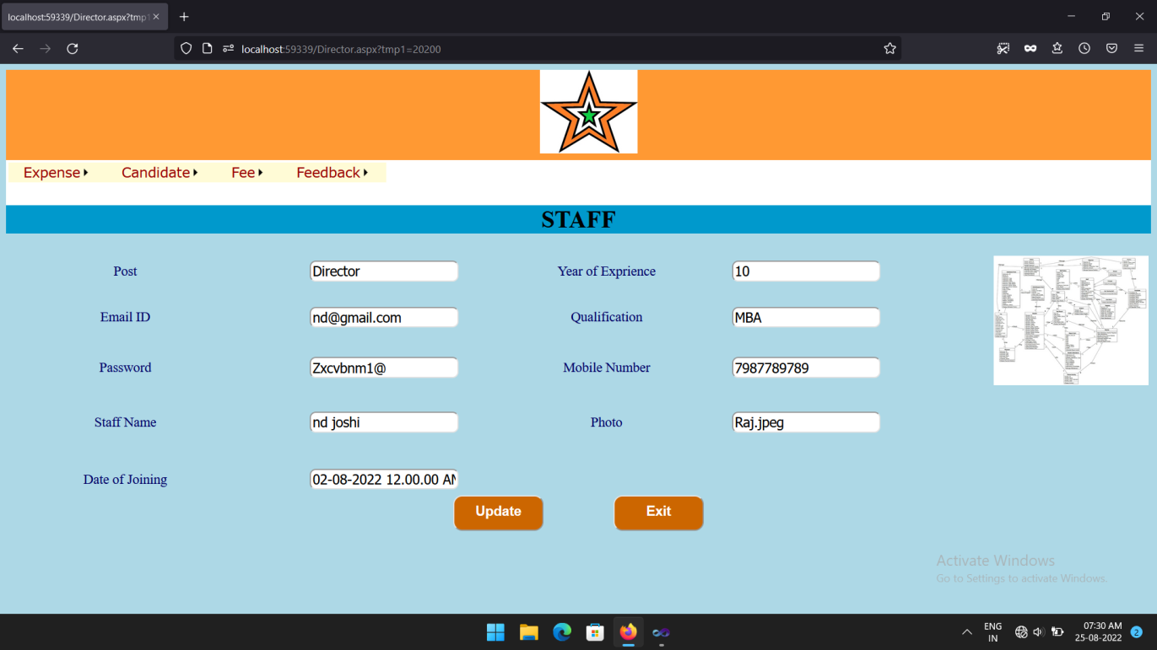

Slide 66
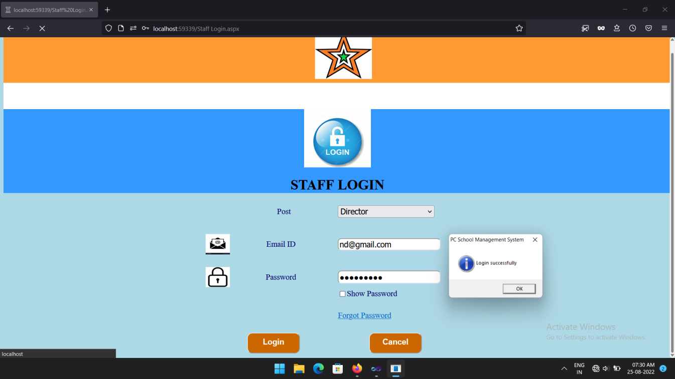

Slide 67
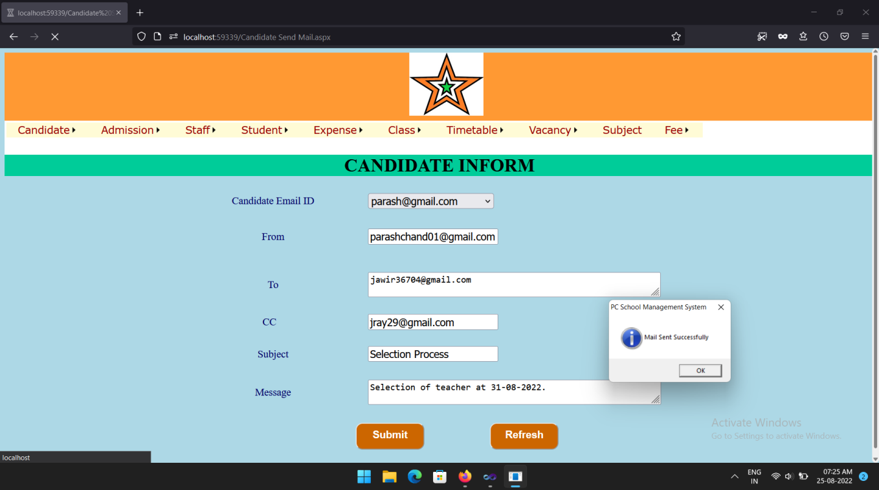

Slide 68
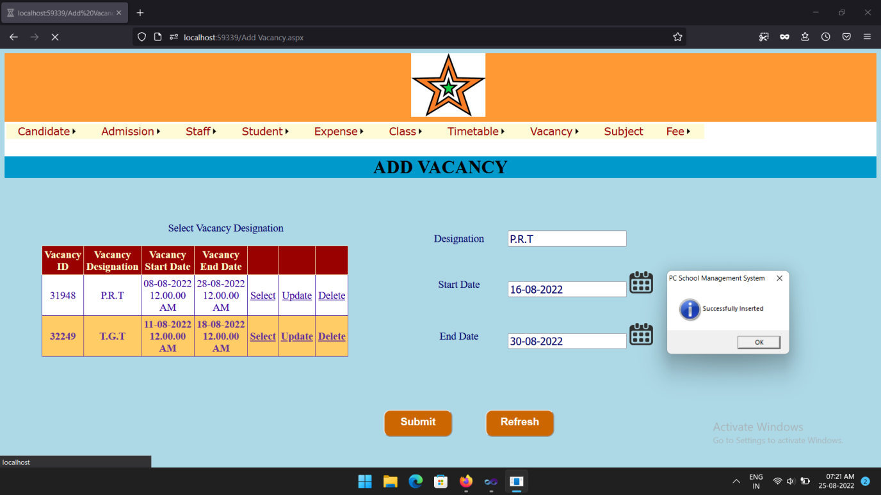

Slide 69
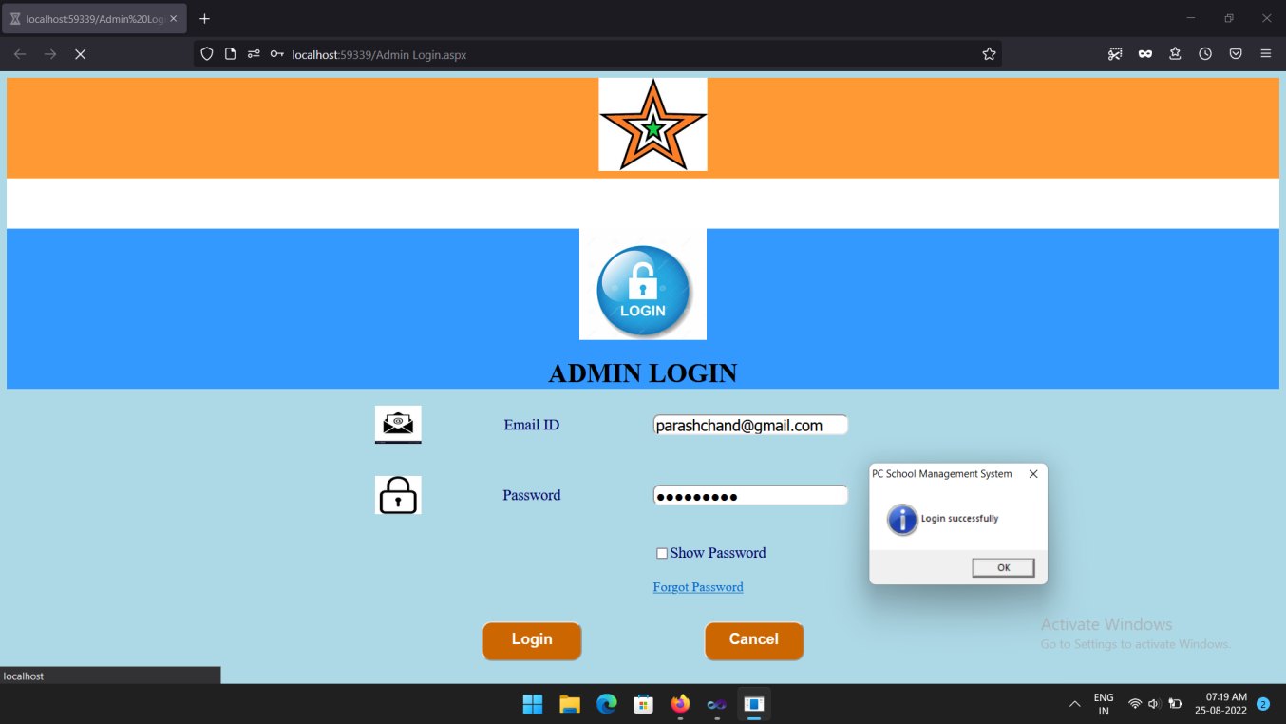

Slide 70
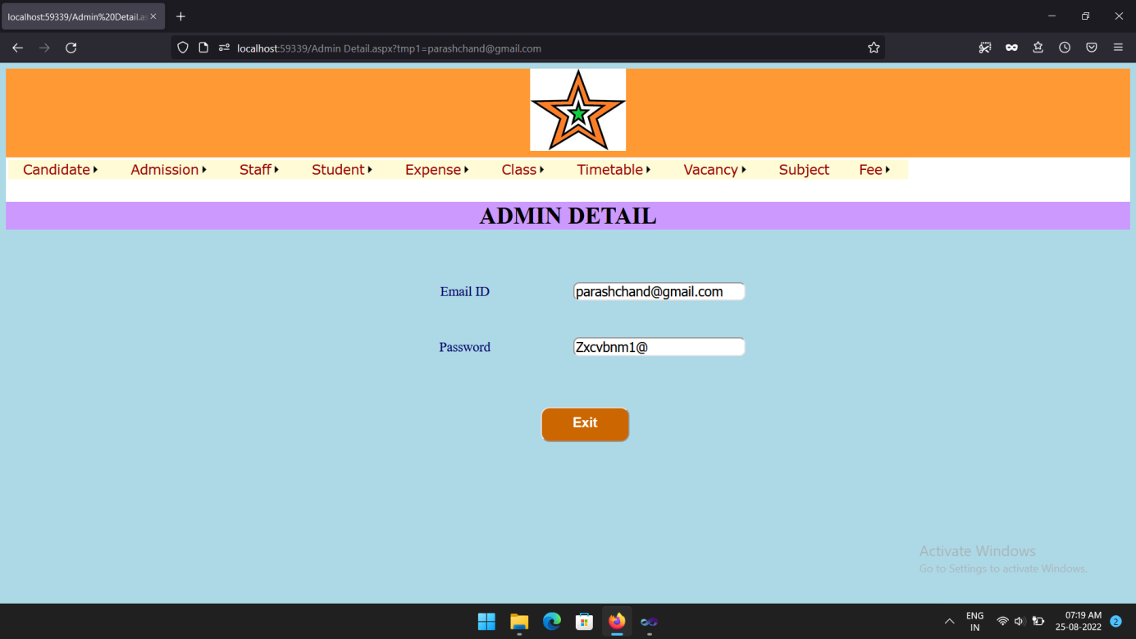

Slide 71
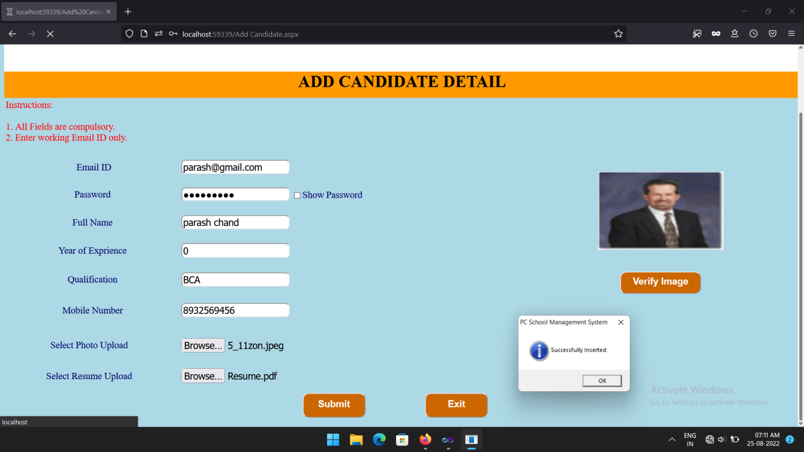

Slide 72
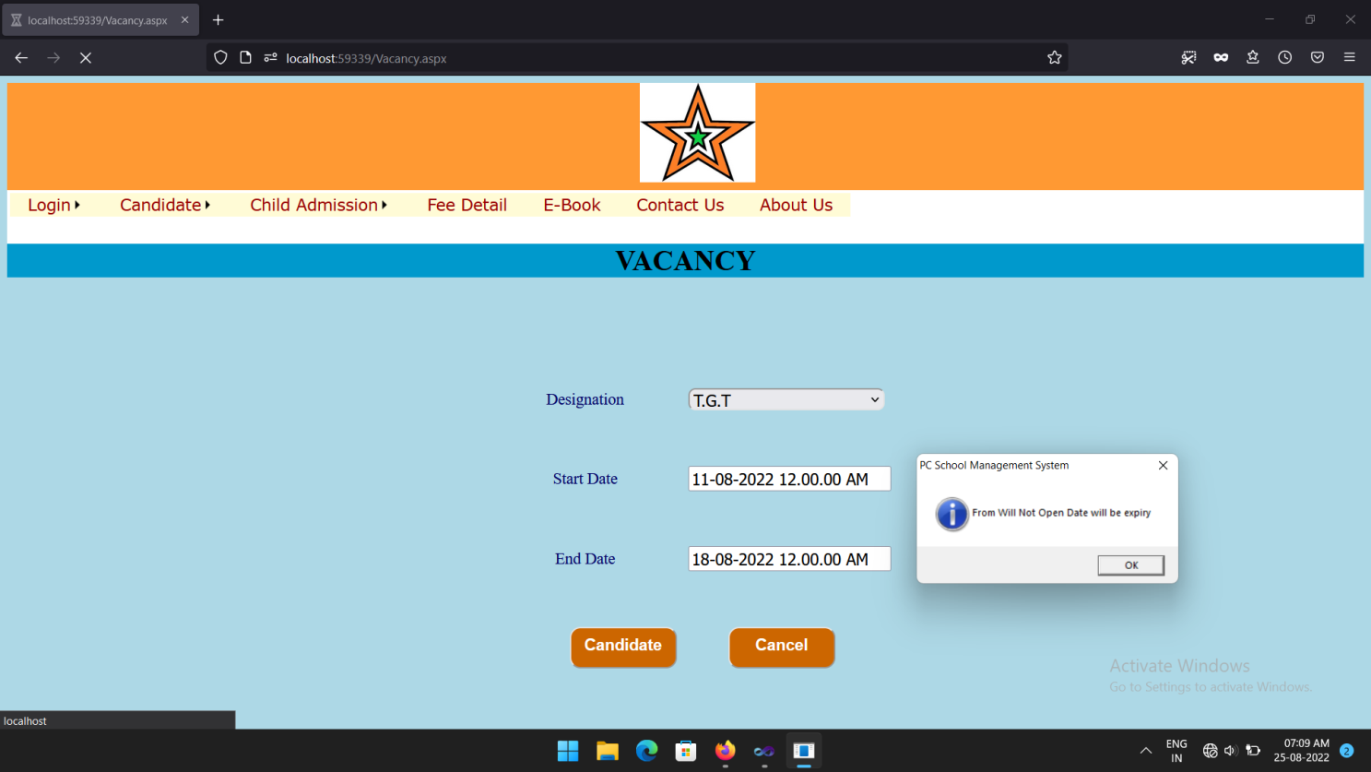

Slide 73
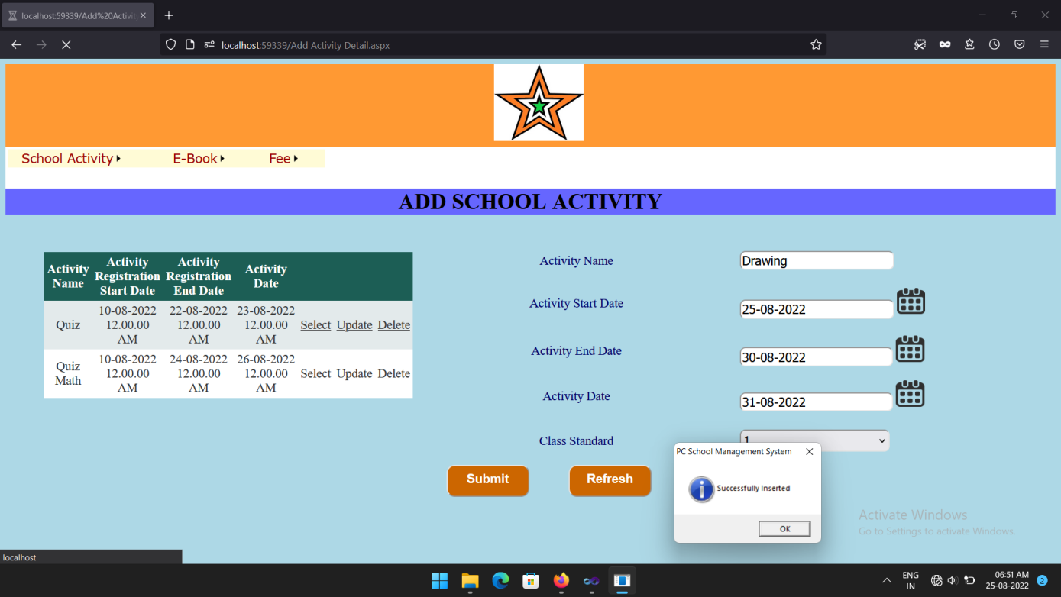

Slide 74
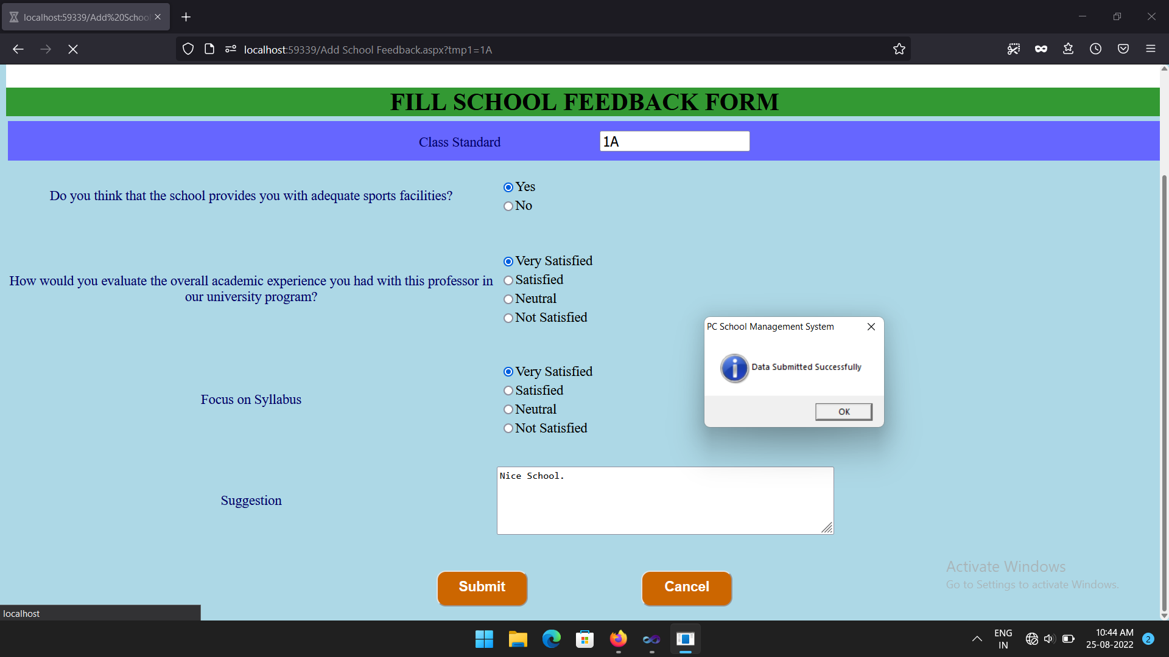

Slide 75
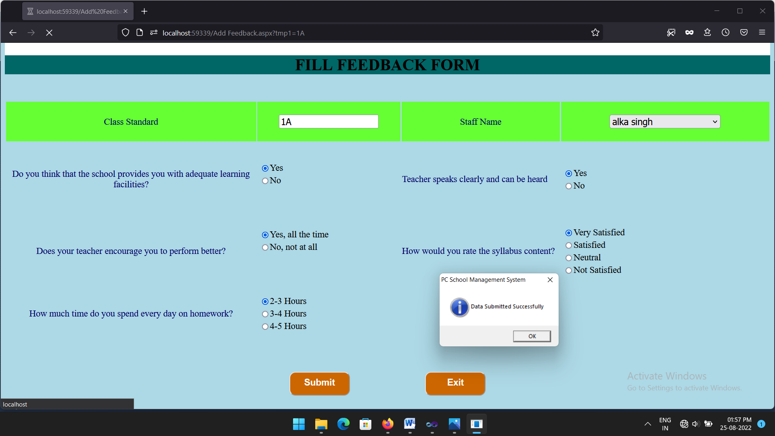

Slide 76
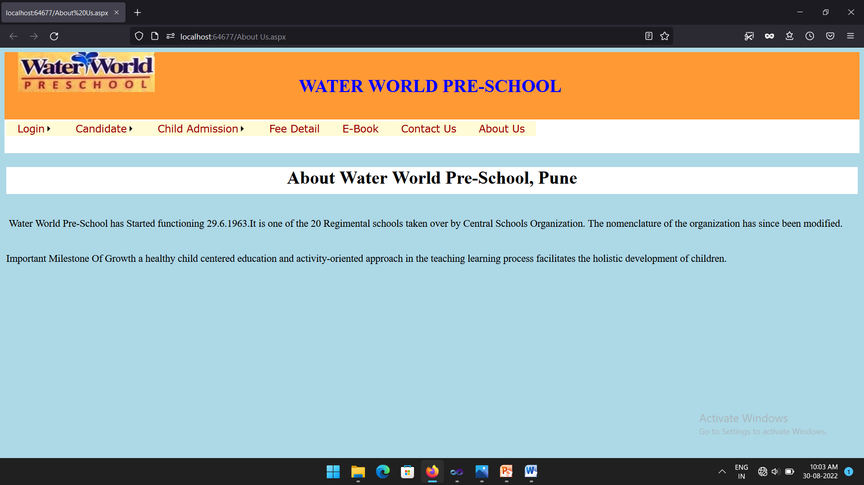

Slide 77
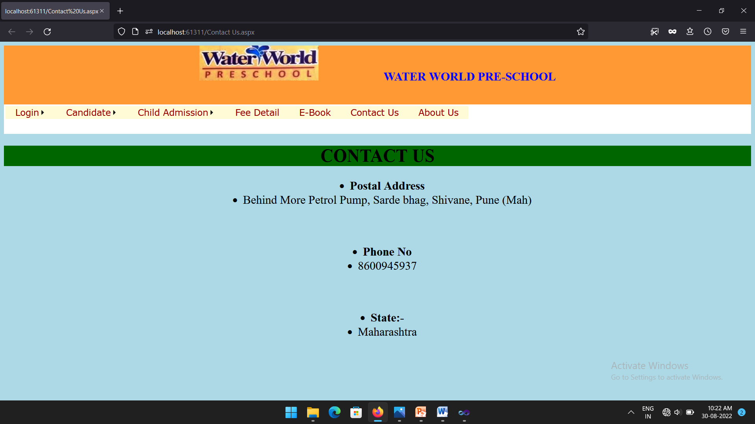

Slide 78
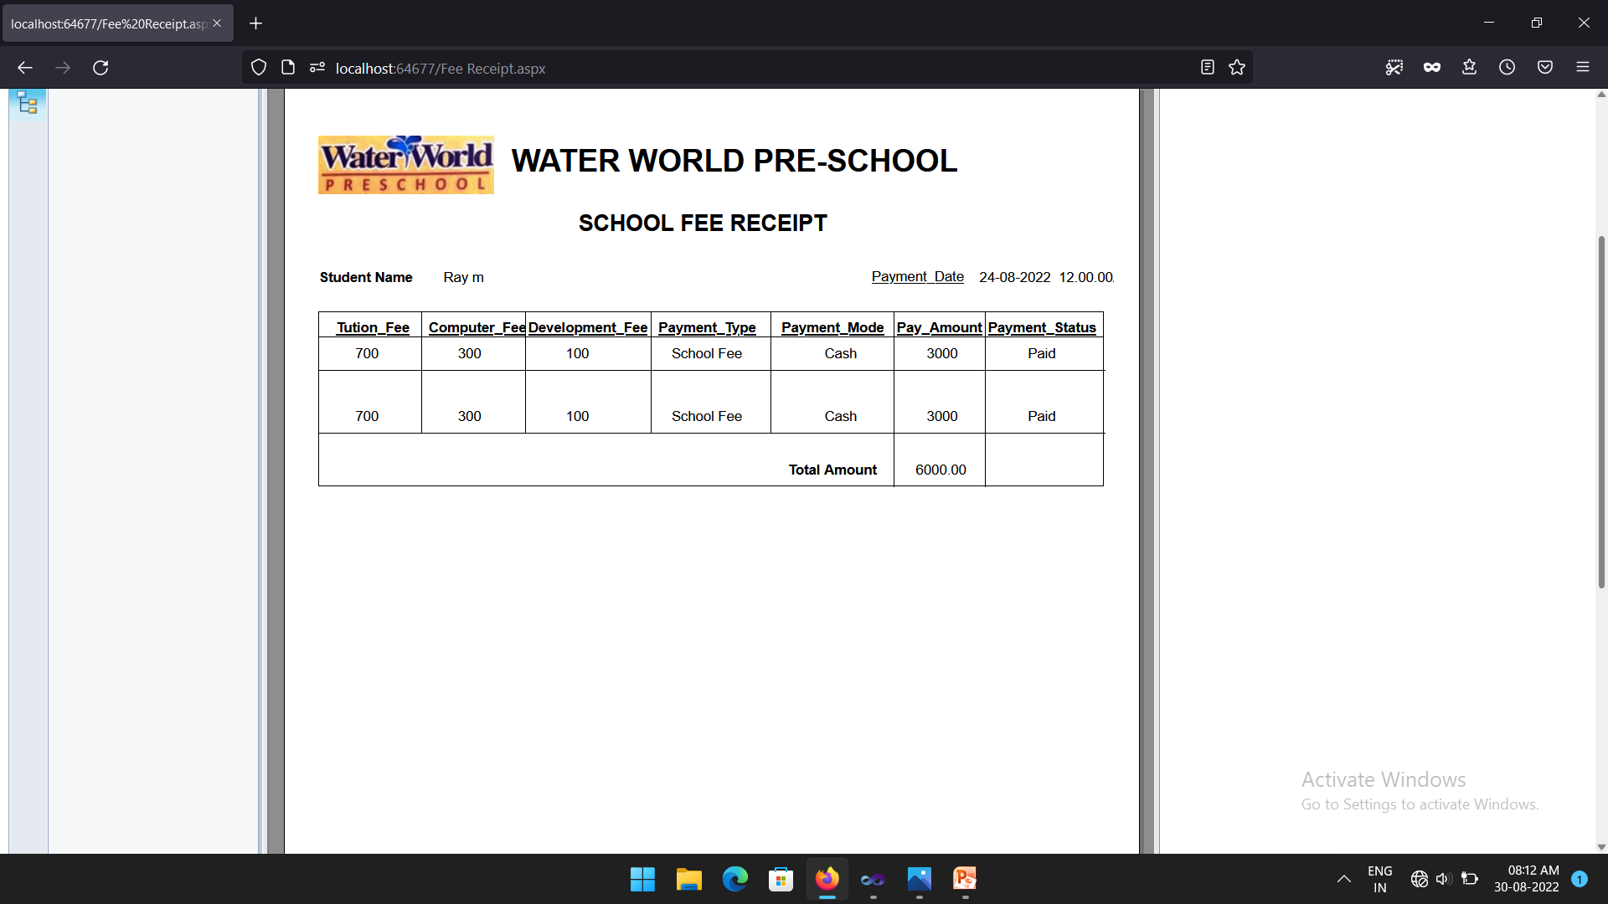

Slide 79
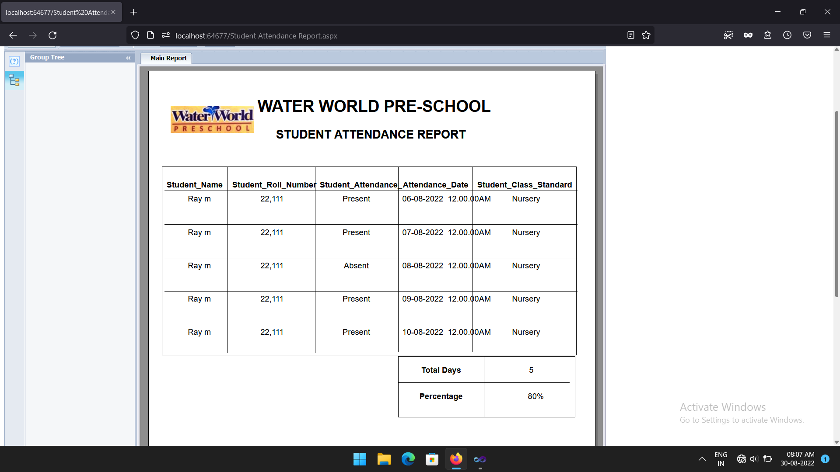

Slide 80
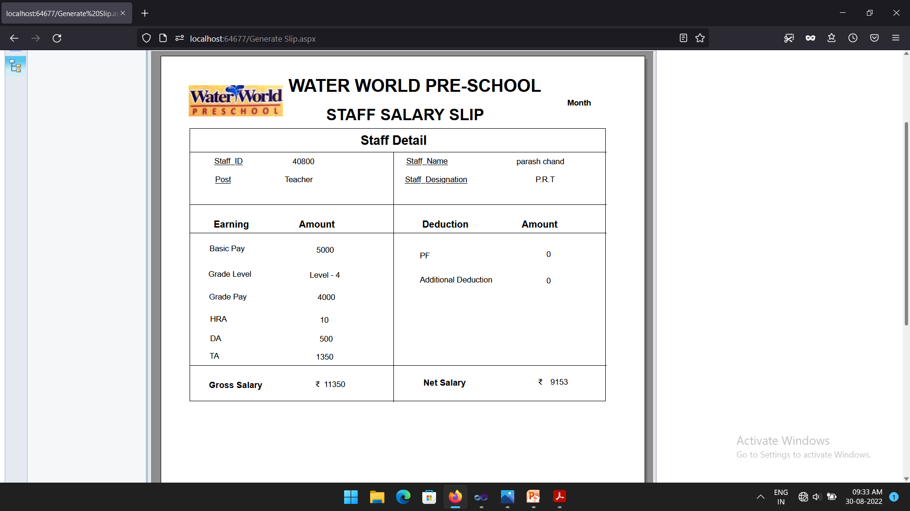

Slide 81
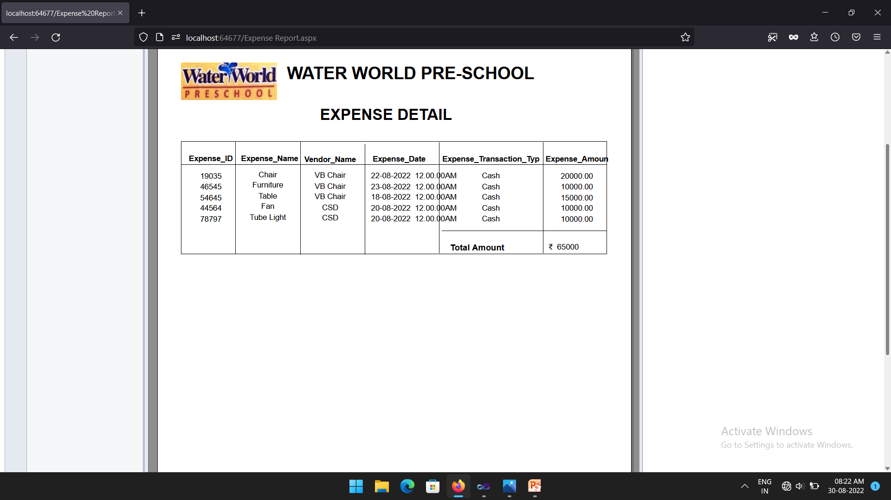

Slide 82
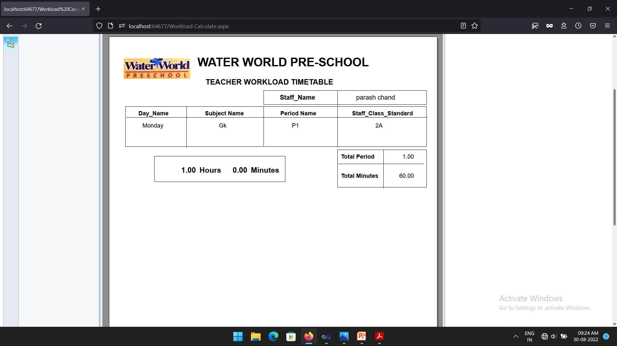

Slide 83
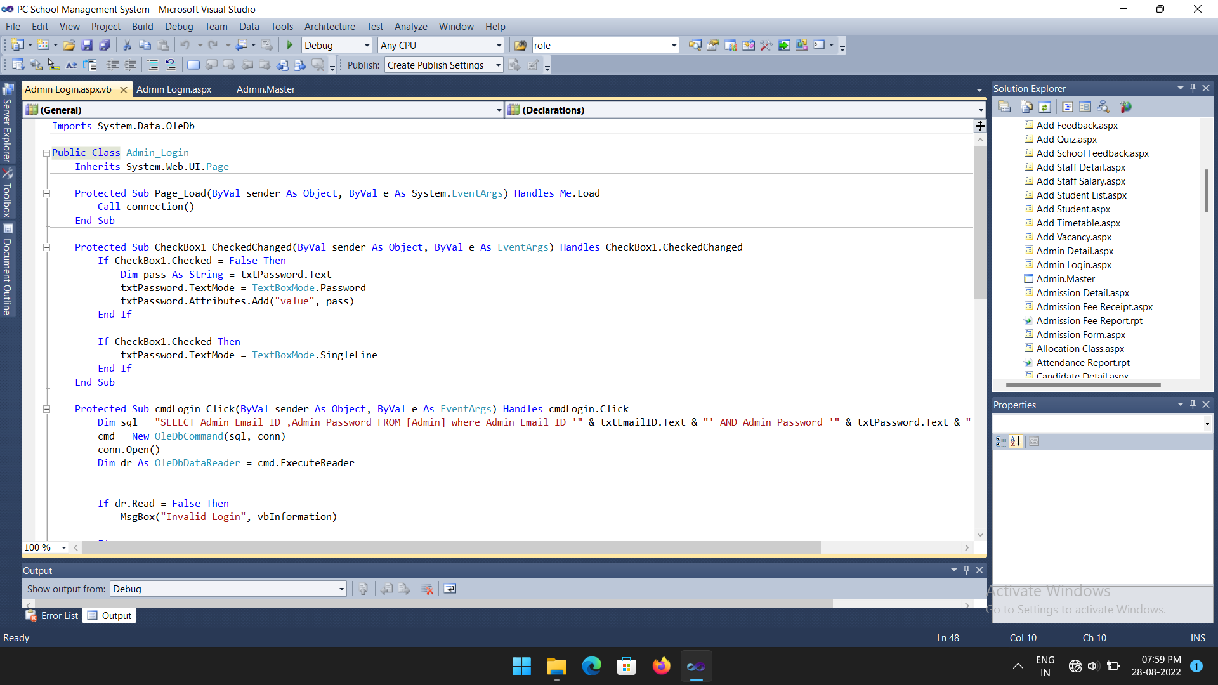
4 Coding 4.1Code Snippet

Slide 84
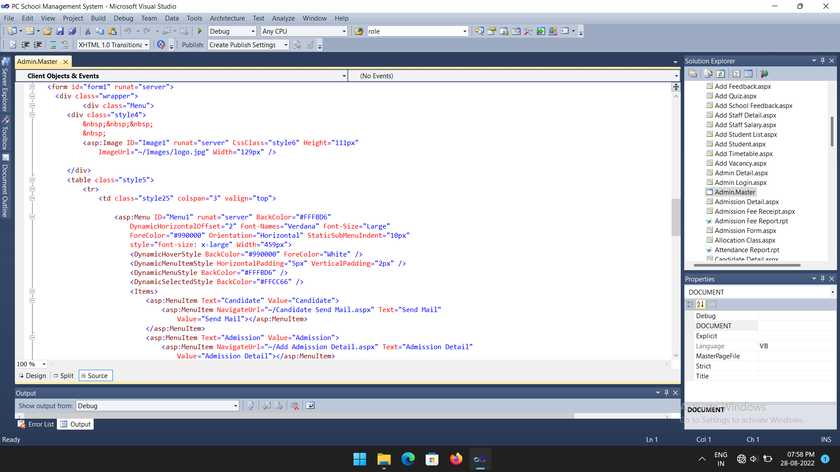

Slide 85
5 Test Procedures and Implementation: -
5.1 Testing objectives:
The testing objectives are summarized in the following three steps:
1) Testing is the process of executing a program with the intent of finding an error.
2) A good case is one that has a high probability of finding an as yet undiscovered error.

Slide 86
5.2 Testing Procedure:
The importance of software testing and its implication with respect to software quality cannot be over emphasized. Software testing is typical element of software quality assurance. Testing represents the ultimate review of specification, design and coding.
Any engineered product can test in one of two ways:
The First approach is called Black Box Testing and the second one is called as White Box Testing.

Slide 87
5.3 Test Plan:
The Test Plan is designed to describe the scope, approach, resources, and schedule of all testing activities.
The Test plan identifies the items to be tested like Authentication, the features to be tested like (for Authentication module) whether user is having privilege to login to the system or not, the types of testing to be performed like Unit Testing, Security Testing, User Interface Testing, Performance Testing, Regression Testing, the resources required to perform testing.
User Interface Testing:
Testing done to ensure that the application operates efficiently and effectively on each client machine
Security Testing:
In Authentication component, user needs to enter his login id and password. If the user name and password is valid then user is allowed to log in. As per the role of user will get the access over the different options

Slide 88
5.4 Test Procedures and Implementation
After successful testing we implemented some of the modules in real-world scenario. The system platform was created for those modules and a limited number of users were also created so that the performance could be tested as well. The system responded as per the expectation, only some performance measures were revealed and corrected accordingly.
The website is uploaded on web server and database is stored Oracle on web server. Performance test was tested for website.
Implementation is the stage where the theoretical design is turned into a working system. The most crucial stage in achieving a new successful system and in giving confidence on the new system for the users that it will work efficiently and effectively.

Slide 89
Test Case
A test case is a document, which has a set of test data, preconditions, expected results and post conditions, developed for a particular test scenario in order to verify compliance against a specific requirement.
Test Case acts as the starting point for the test execution, and after applying a set of input values, the application has a definitive outcome and leaves the system at some end point or also known as execution post condition.
Test Case ID | Test Case Name | Pre-Requisites | Steps To Be Executed | Expected Results | Actual Results | Pass/ Fail
TC1 | Check login | Application should be running and input should be displayed | Enter username Enter password | Valid message should be displayed | Message box “ login successfully” is displayed | Pass
TC2 | Enter valid mobile number | Application should be running and input should be displayed | Enter alphabets mobile number | Invalid message should be displayed | Message box “ enter correct mobile number” is displayed | Pass

Slide 90
TC3 | Activity login | Message box should be displayed | Enter student roll number | Invalid message should be displayed | Message box “ invalid login” is displayed | Pass
TC4 | Fill admission form | Page redirect to admission page | Check admission detail. If admission date is expiry | Message should be displayed “from will not open date will be expiry” | Message should be displayed “from will not open date will be expiry” | Pass
TC5 | Fill activity registration form | Message box should be displayed | Student enter same data again | Message should be displayed “Record already exits” | Message should be displayed “Record already exits” | Pass
TC6 | Add activity start date and end date | Message box should be displayed | Teacher will add date | Message should be displayed “date is incorrect” | Message should be displayed “date is incorrect” | Pass
TC7 | Check admission after end date | Message box should be displayed | Child click admission button | Message should be displayed “date is expiry” | Message should be displayed “date is expiry | Pass
TC8 | Check admission before end date | Check admission date | Child click admission button | Admission form will open | Admission form will open | Pass

Slide 91
6 Limitation of Proposed System
1. Fortunately, there aren’t many. The most common issue schools/teachers/students/parents face while using a student management system is: a complex user interface. And that’s a solvable issue.
2. We’re humans and we need some time to adapt things. If the tool you’re using is genuinely tough to use, you can go for a tool that’s simple or get training.
3. Applications face minor technical glitches and these systems are no loading.
4. For new user it is difficult to understand the features of application.
5. Absence of proper internet-network makes it difficult for a user to access information.

Slide 92
7 Proposed Enhancements
Considerable efforts have made the software easy to operate even for the people not related to the field of computers but it is acknowledged that may find it bit problematic at the first instance. However, the software provides friendly message to interact with the system easy to use.
Export has not been developed due to some criticality (The exported information can save as means of backup).
1. Automatic student promote to next class.
2. Making online payment gateway for easy to use.
3. Fee deduction as per cast category.
4. Evaluation student marks in a statistics way.

Slide 93
8 Conclusion
The PC School Management System is properly performed to satisfy all the important requirements that we want in school. The older system was tackled with so many problems/issues. The present project has been developed to make work easy and efficient. This system is automated system i.e., only use of machine for work.
Software which capable of storing school resources such as students and staff of the school and their relationship was implemented. It is easily to record their details of students and courses they have taken, courses and teacher they are given by using the friendly interface of the system.
The system developed to be user friendly and efficient in achieving basic goals. The system is found to be really beneficial for the concerned aspects.

Slide 94
9 Bibliography
1. https://www.aspsnippets.com/Articles/Save-and-Retrieve-images-from-database-in-ASPNet.aspx
2. https://www.c-sharpcorner.com/article/insert-data-into-database-and-show-in-gridview-in-asp-net-c-sharp/
3. E-Book ASP.Net Framework 3.5 Web Site Using C# & VB.
4. E-Book Build Your Own ASP.NET 4 Web Site Using C# & VB.
5. https://www.aspsnippets.com/Articles/Insert-multiple-Selected-Checked-records-from-GridView-to-Database-in-ASPNet.aspx

Slide 95
10 User manual
Student fill feedback form according to class and teacher name. After submit it show message successfully.

Slide 96
Class teacher take attendance of student day wise.

Slide 97
Staff mark register it will help to calculate salary of staff (i.e. Teacher and Non-teaching staff).

Slide 98
Child enter email id and password if correct show login successfully.

Slide 99
THANK YOU

